Slide 1
锚函数-研究语言模型的一类简单函数
许志钦
上海交通大学
2025年10月5日星期日

Slide 2
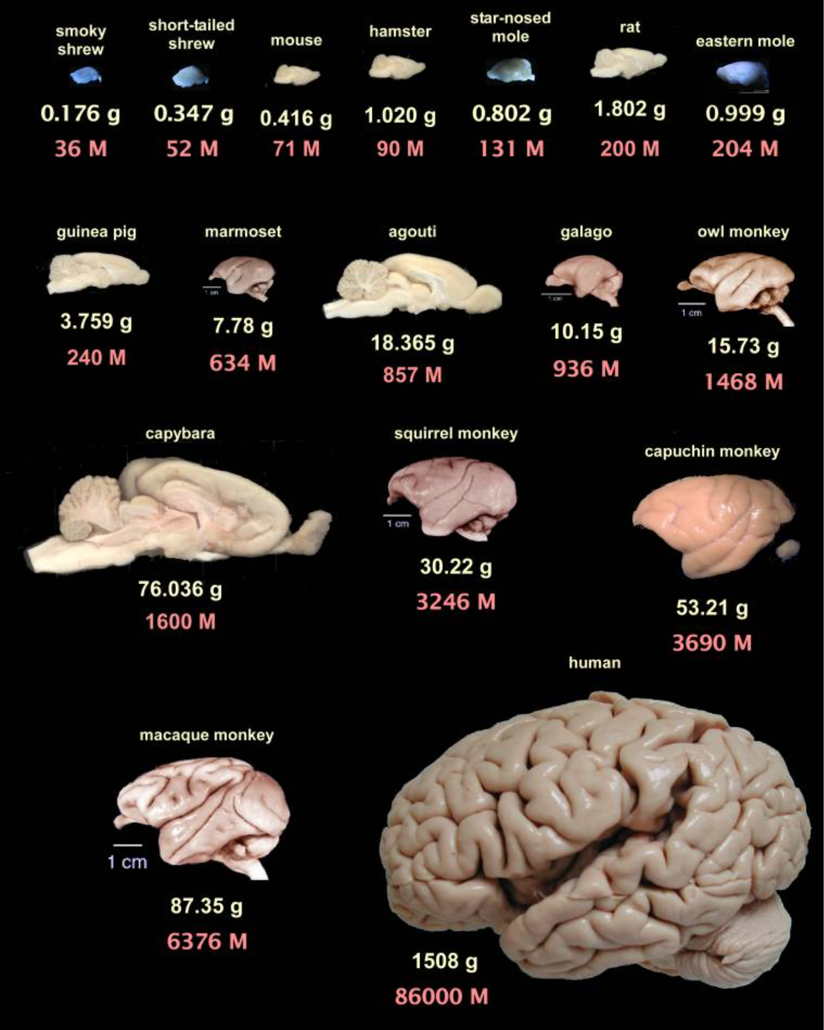
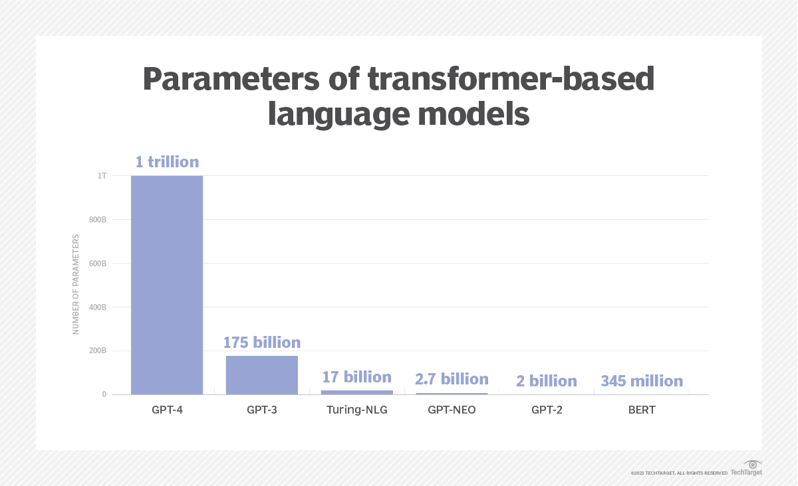
Increasingly large size

Slide 3
Difficulties
Complex data structure.
“calculate the product of the first two numbers: 10, 20, 30”
alternative ways
Multiple tokens together to execute an operation
Unknown target functions：Next-Token Prediction without specifying any task
Large computational cost and memory for academic groups
prepare data for a specific task
Interpretability for the inferring process.
……

Slide 4
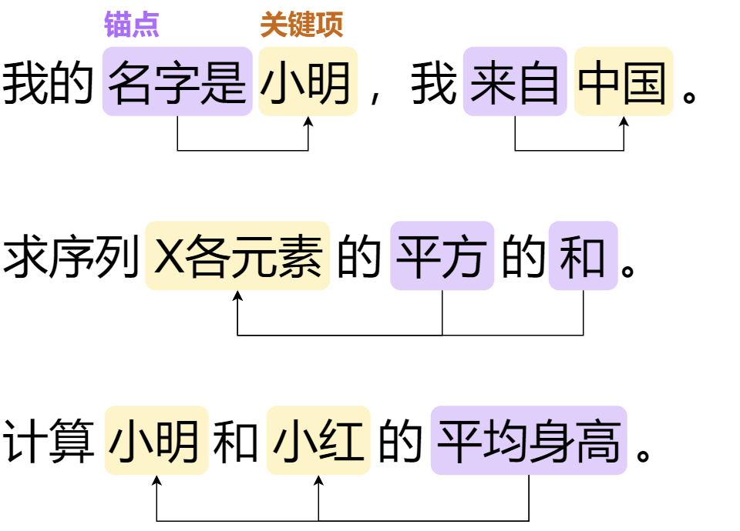
自然语言数据存在常见类型
Anchor-key
“I am from China, my name is john, I like reading.”
What is his name?
What does he like?
Where is he from?
“summation of 1,16,17” and “product of 1,16,17”
三段论推理模式
所有A 是B，C 是A，因此C 是B
“某学校所有的老师是教授，小明是该学校的老师，那么可以推出小明是教授”

Slide 5

How to study?
Conducting diabetes research using mice
Biological similarity: Mice have a high degree of physiological and genetic similarity to humans.
Low time consumption: Mice have a shorter life cycle.
High cost-effectiveness: Mice are easier to breed and maintain, resulting in lower research costs.
Manipulable and controllable variables: Mice genes can be easily modified, enabling the creation of specific gene knockout or knockin models.
Notes:
用小白鼠进行糖尿病研究 1、生物间相似性：小鼠与人类在生理和遗传学上有很高的相似性，很多人类基因的功能在小鼠身上有相似的基因对应 2、时间花费低：小鼠的生命周期较短，研究人员可以可以花费更少的时间成本，观察到疾病的全过程 3、成本效益高：与其他较大的哺乳动物模型相比，小鼠更容易饲养和繁殖，研究成本更低 4、可人为操控修改，易于控制变量：小鼠的基因容易通过遗传工程技术进行修改，可以创建特定基因敲除或敲入的模型，用于研究这些基因在糖尿病发病中的作用

Slide 6
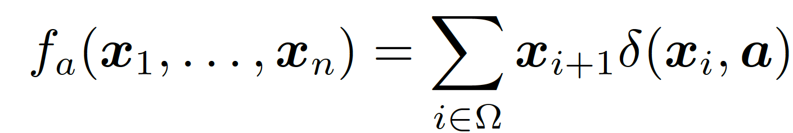
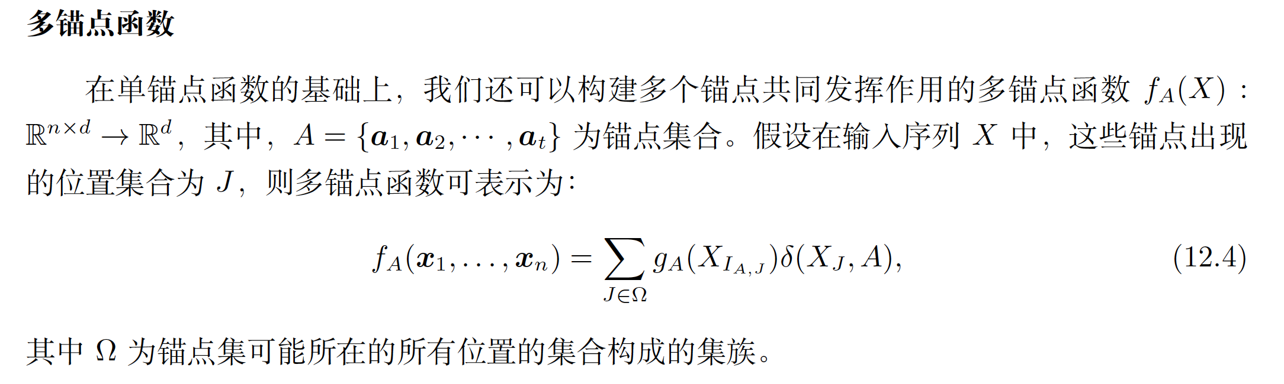
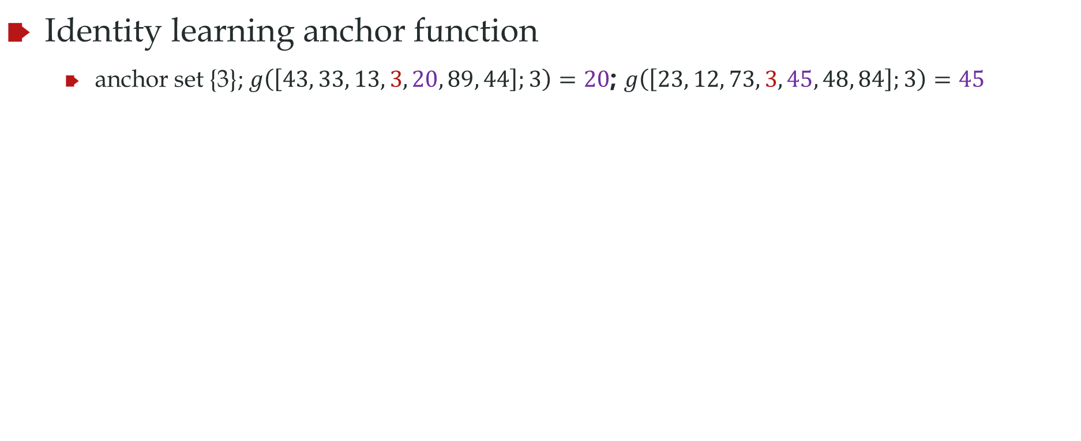
Anchor function
Identity learning anchor function
anchor set {3}; $g\left(\left[43, 33, 13, 3, 20, 89, 44\right];3\right)=20$; $g\left(\left[23, 12, 73, 3, 45, 48, 84\right];3\right)=45$
Anchor：3；key: 20
Anchor：3；key: 45
Zhongwang Zhang#, Zhiwei Wang#, Junjie Yao, Zhangchen Zhou, Xiaolong Li, Weinan E, Zhi-Qin John Xu*, Anchor function: a type of benchmark functions for studying language models, arxiv 2401.08309

Slide 7
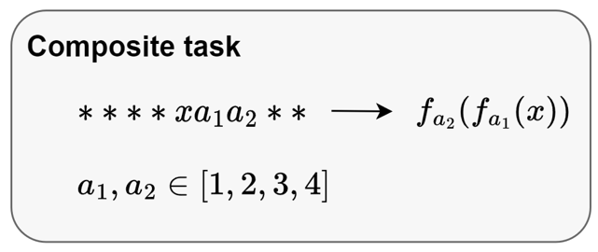
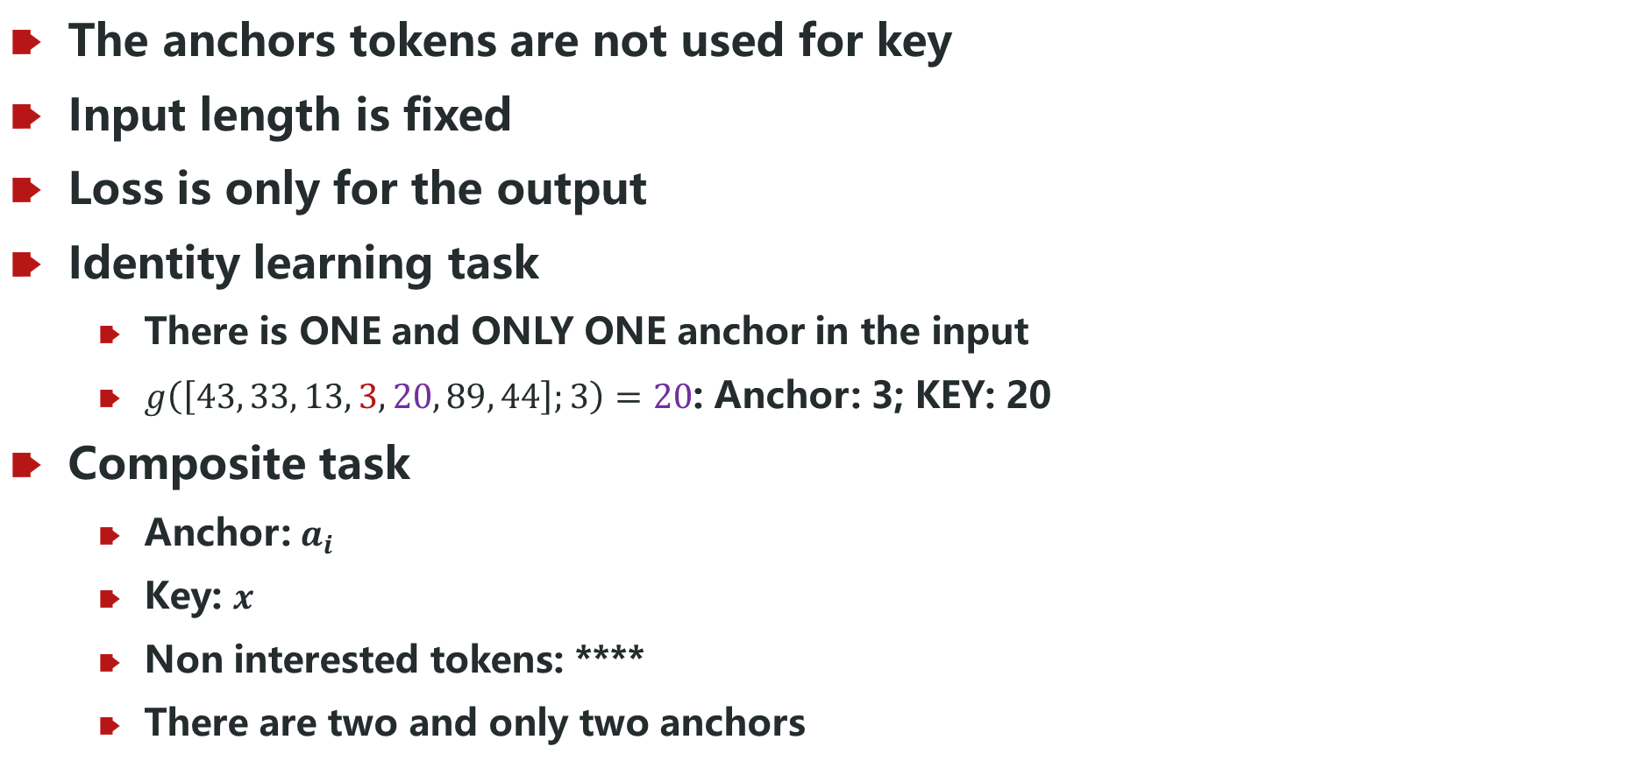
Anchor function
The anchors tokens are not used for key
Input length is fixed
Loss is only for the output
Identity learning task
There is ONE and ONLY ONE anchor in the input
$g\left(\left[43, 33, 13, 3, 20, 89, 44\right];3\right)=20$: Anchor: 3; KEY: 20
Composite task
Anchor: $a_{i}$
Key: $x$
Non interested tokens: ****
There are two and only two anchors
Zhongwang Zhang#, Zhiwei Wang#, Junjie Yao, Zhangchen Zhou, Xiaolong Li, Weinan E, Zhi-Qin John Xu*, Anchor function: a type of benchmark functions for studying language models, arxiv 2401.08309

Slide 8
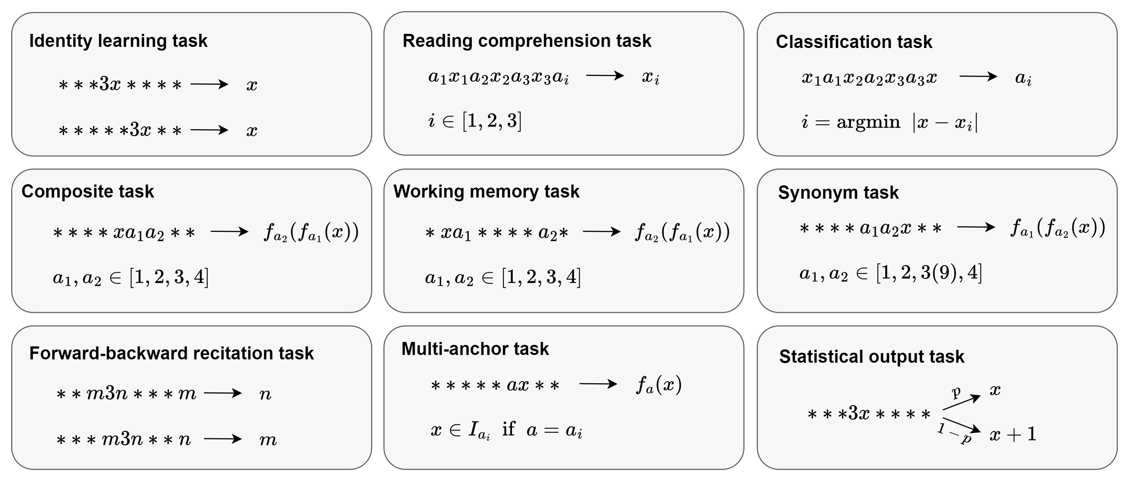
Anchor function
Zhongwang Zhang#, Zhiwei Wang#, Junjie Yao, Zhangchen Zhou, Xiaolong Li, Weinan E, Zhi-Qin John Xu*, Anchor function: a type of benchmark functions for studying language models, arxiv 2401.08309

Slide 9
How to separate training and test data?

Slide 10
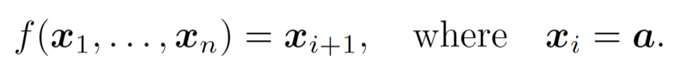
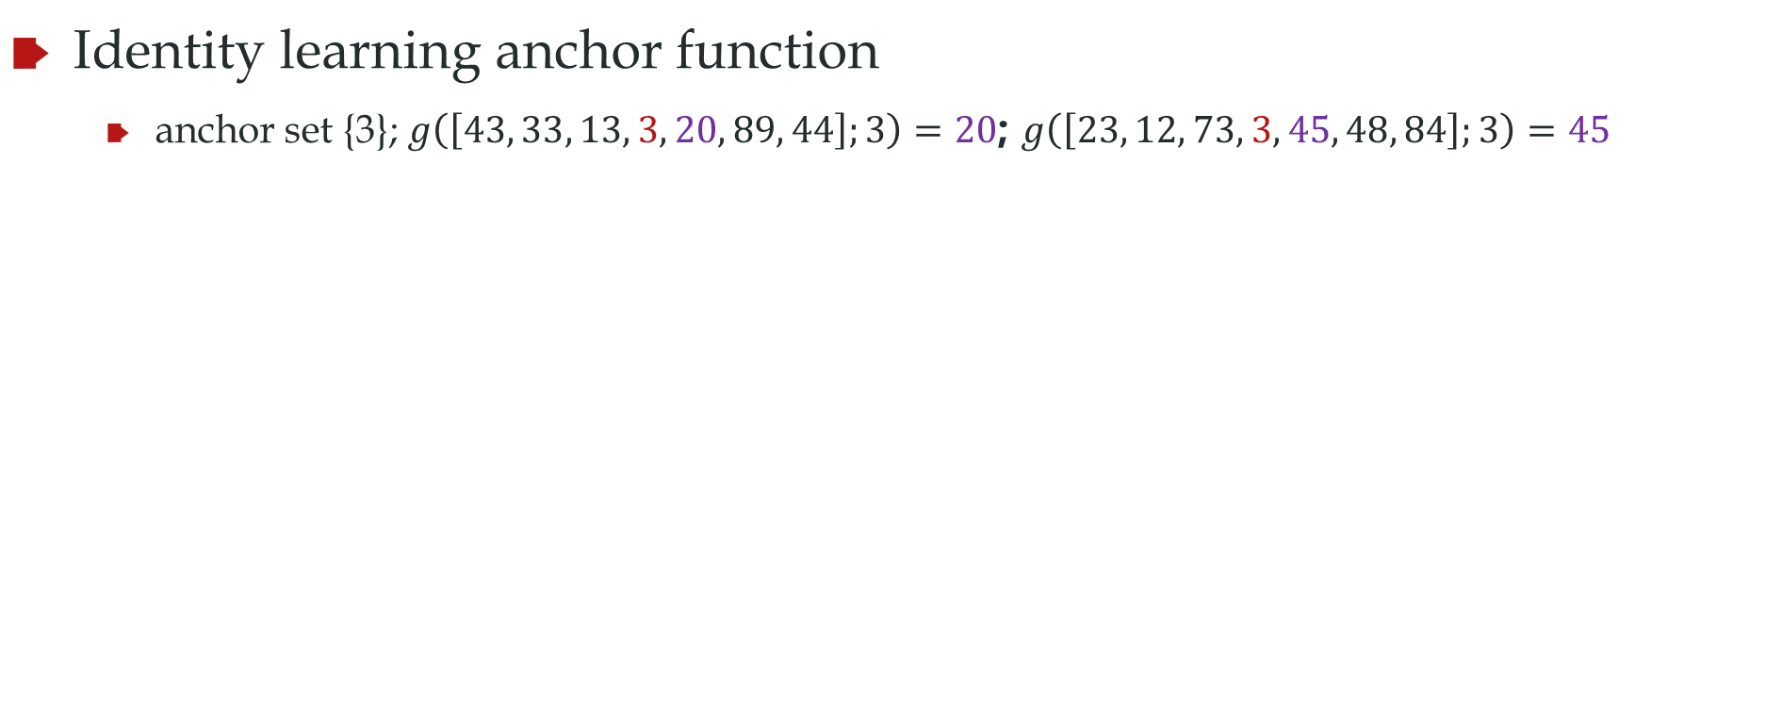
Anchor function: training and test data
anchor set A
Identity learning anchor function
anchor set {3}; $g\left(\left[43, 33, 13, 3, 20, 89, 44\right];3\right)=20$; $g\left(\left[23, 12, 73, 3, 45, 48, 84\right];3\right)=45$
Training data [20,60]
Test data [61,80]
NN never sees [61,80]

Slide 11
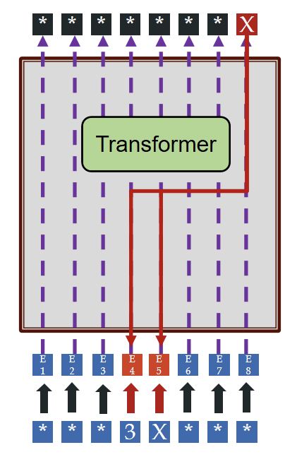
参数更新

Slide 12
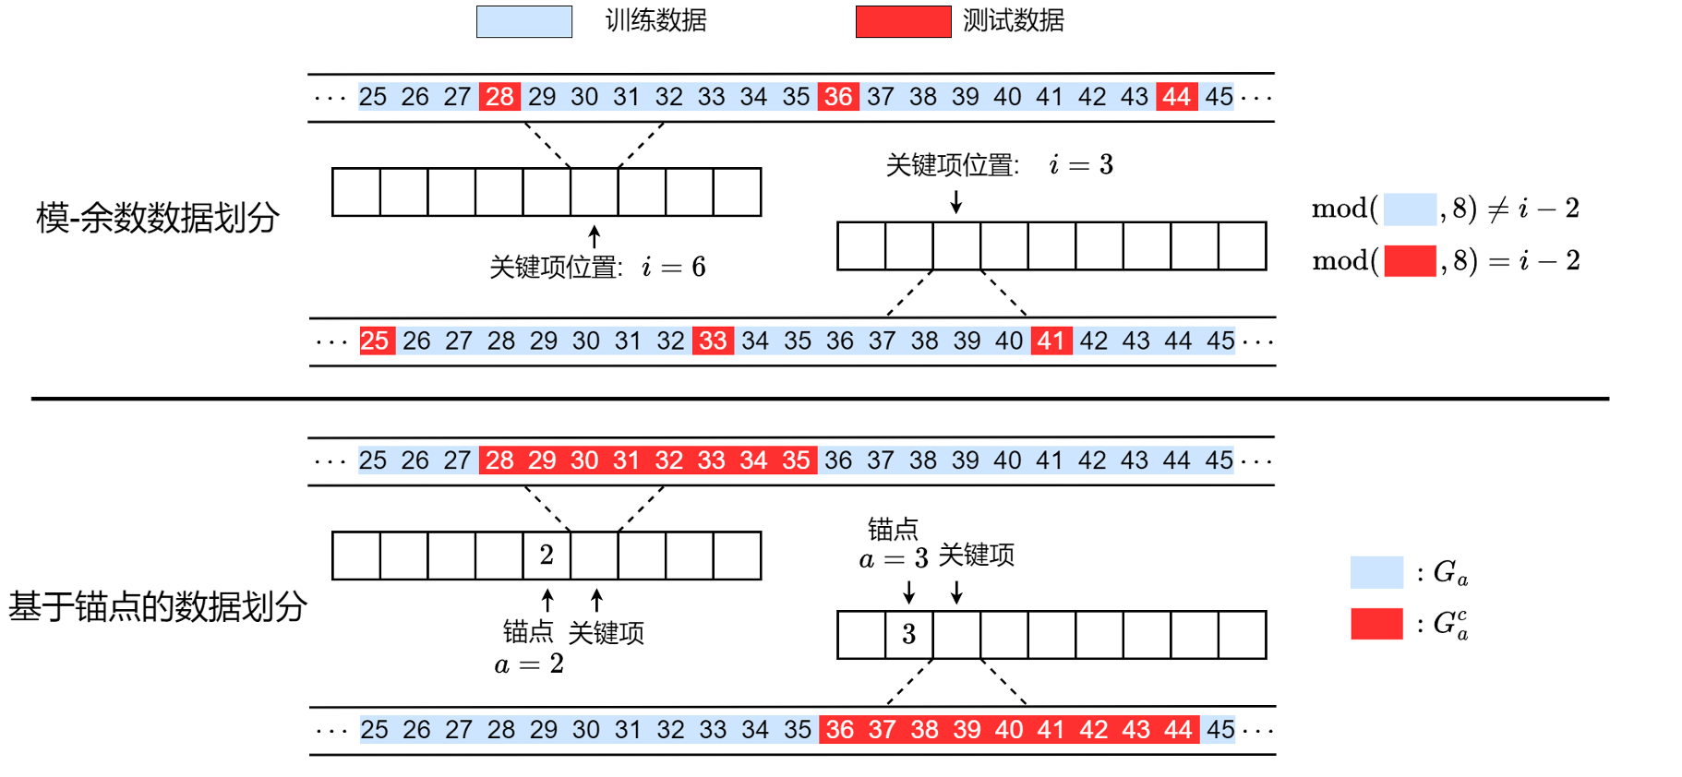
Anchor function: training and test data

Slide 13
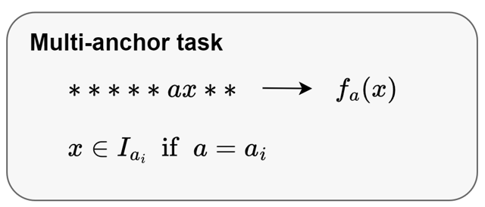
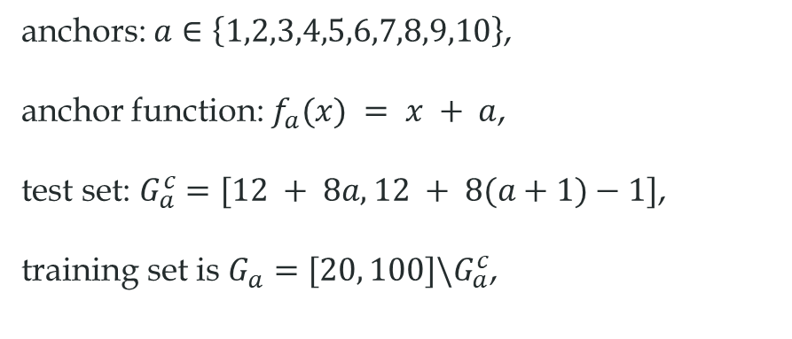
Anchor function: training and test data
anchors: $a∈\left\{1,2,3,4,5,6,7,8,9,10\right\}$,
anchor function: $f_{a}(x) = x + a$,
test set: $G_{a}^{c}=[12 + 8a, 12 + 8(a+1)−1]$,
training set is $G_{a}=[20, 100]\backslash G_{a}^{c}$,

Slide 14
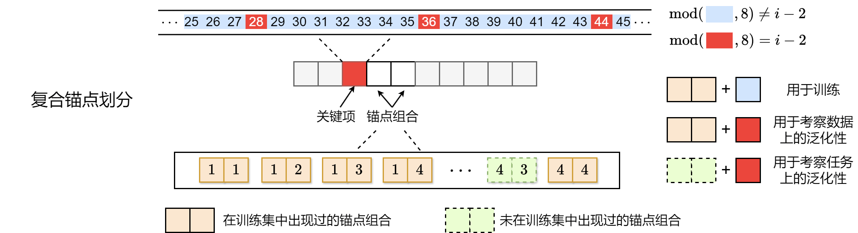
Anchor function: training and test data

Slide 15
数据泛化与任务泛化
Zhongwang Zhang#, Zhiwei Wang#, Junjie Yao, Zhangchen Zhou, Xiaolong Li, Weinan E, Zhi-Qin John Xu*, Anchor function: a type of benchmark functions for studying language models, arxiv 2401.08309

Slide 16
Anchor function
Designated Token as Anchor
Other Token as Key
Data set
(21, 1, 2, 27)
(29, 2, 1, 35)
(50, 2, 1, 56)
(29, 3, 3, 25)
(46, 4, 4, 30)
1
:
+5
5
Train model to predict Targets
2
:
+1
6
3
:
-2
…
…
4
:
-8
100
Key
Anchor
Target

Slide 17
NN to learn Anchor function
Loss only here
Calculate loss
Data set
NN
Output
Target
(21, 1, 2, 27)
(29, 2, 1, 35)
(50, 2, 1, 56)
(29, 3, 3, 25)
(46, 4, 4, 30)
. . .
…
5
1
2
Key
Anchor
Target
Other Token as Key
Designated Token as Anchor

Slide 18
数据泛化与任务泛化
Loss only here
Calculate loss
Data generalization
Task generalization
Output
Target
This comb is not seen during training
NN
. . .
(21, 1, 2)
(21, 4, 3)
Anchor pair is seen
Anchor pair NOT seen
5
1
2
Anchor pair (4,3) and (3,4) NOT seen
Other Token as Key
Designated Token as Anchor

Slide 19
Anchor function
Can simulate a series of language tasks.
Computation and memory cost are reasonable for academic groups.
The target function is well defined.
The training data and the test can be clearly separated
Experiments can be conducted with strict control of variables.
Study the generalization within one task or the generalization from a certain tasks to unseen tasks.
Study the advantage of transformer over FNN

Slide 20
Study on different tasks
Zhongwang Zhang#, Zhiwei Wang#, Junjie Yao, Zhangchen Zhou, Xiaolong Li, Weinan E, Zhi-Qin John Xu*, Anchor function: a type of benchmark functions for studying language models, arxiv 2401.08309

Slide 21
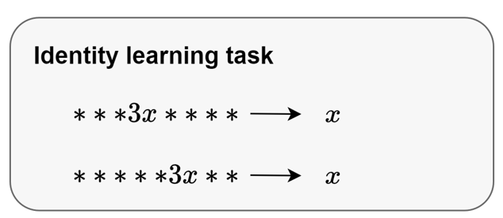
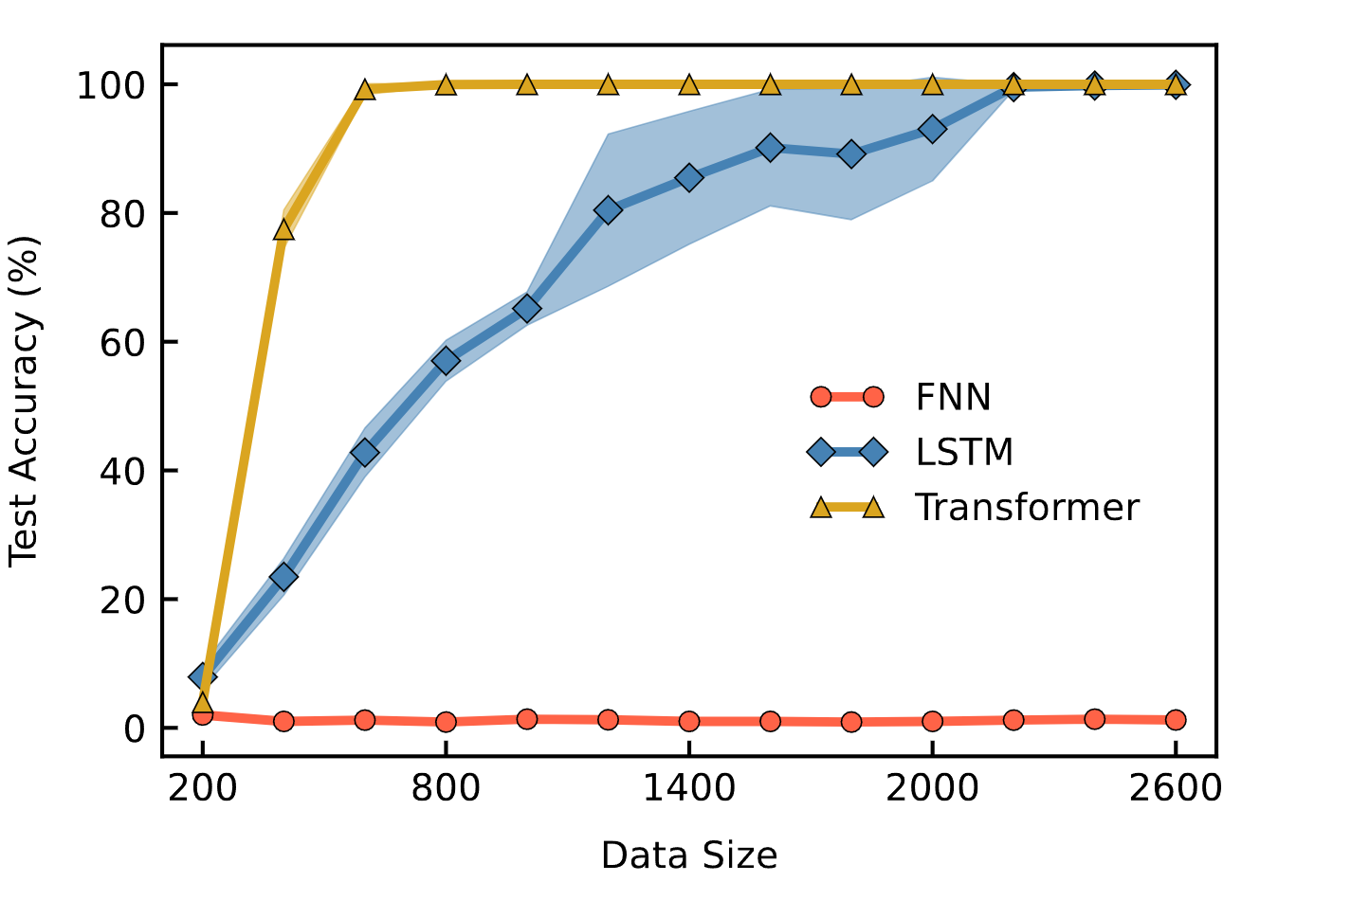
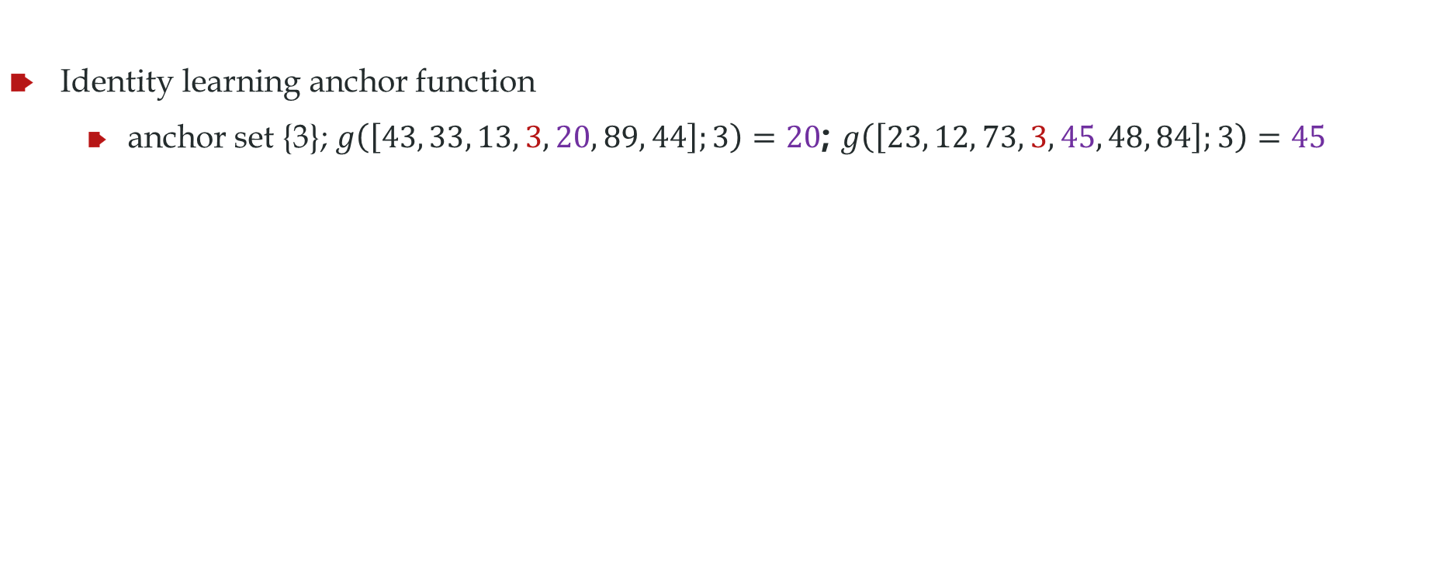
Identity learning task
anchor set A
Identity learning anchor function
anchor set {3}; $g\left(\left[43, 33, 13, 3, 20, 89, 44\right];3\right)=20$; $g\left(\left[23, 12, 73, 3, 45, 48, 84\right];3\right)=45$
4-layer, 4 heads decoder-only transformer, 5.6M
4-layer LSTM, 5.3M
4-layer Fully-connected NN, 416M
Even this task can study the advantage of transformer over FNN

Slide 22
Forward-backward recitation task
背古诗
春江潮水连海平， --张若虚《春江花月夜》
， 润物细无声。--杜甫《春夜喜雨》

Slide 23
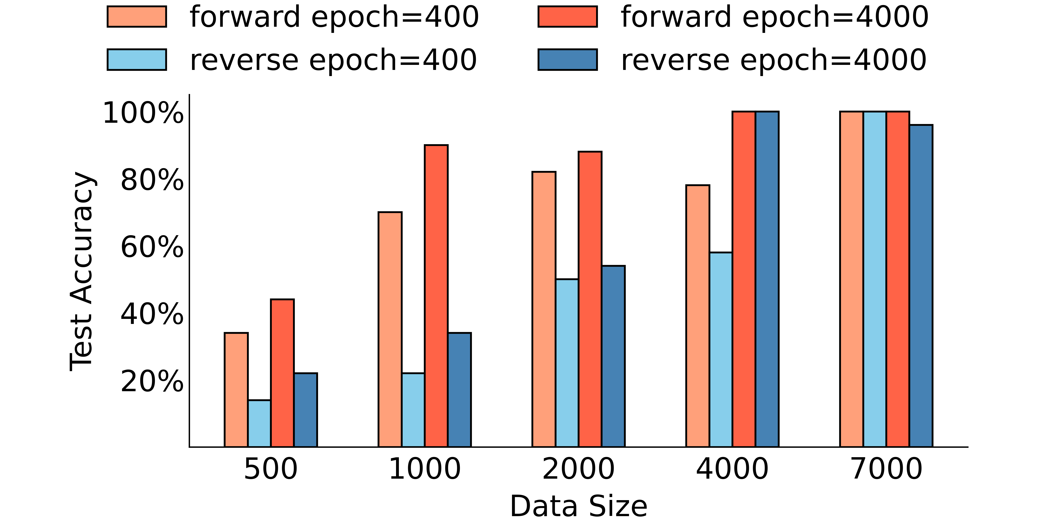
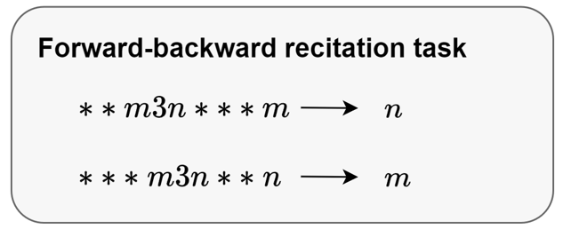
Forward-backward recitation task
背古诗
春江潮水连海平，海上明月共潮生。--张若虚《春江花月夜》
随风潜入夜， 润物细无声。--杜甫《春夜喜雨》
Data size large, no difference

Slide 24
Reading comprehension task
春天到了，公园里的景色真美丽。草地上长出碧绿的小草，像铺上了绿地毯。花盆里的花都开了，有红的，黄的，白的，紫的，暗红的，十分好看。
这段话写公园的景色很美丽。主要写了地上的______和花盆里的______十分好看。
日月潭是一个美丽的大湖，它在我国台湾省的中部。日月潭里有个小岛把潭分成两半。潭的一边像圆圆的太阳，叫“日潭”；另一边像弯弯的月亮，叫“月潭”。两潭湖水相连，像个碧绿的大玉盘。小岛就像玉盘中的明珠。日月潭的四周是山，山上是茂密的树林。日月潭的水很深。山林倒映在潭里，湖光山色，非常美丽。我爱美丽的日月潭，我爱祖国的台湾岛。
小岛把潭分成两半。潭的一边像____________，叫“______”，另一边像____________，叫“______”。两潭湖水相连，像个____________，小岛就像____________。

Slide 25
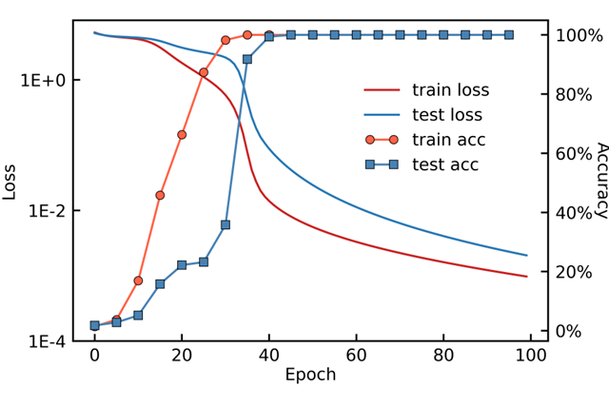
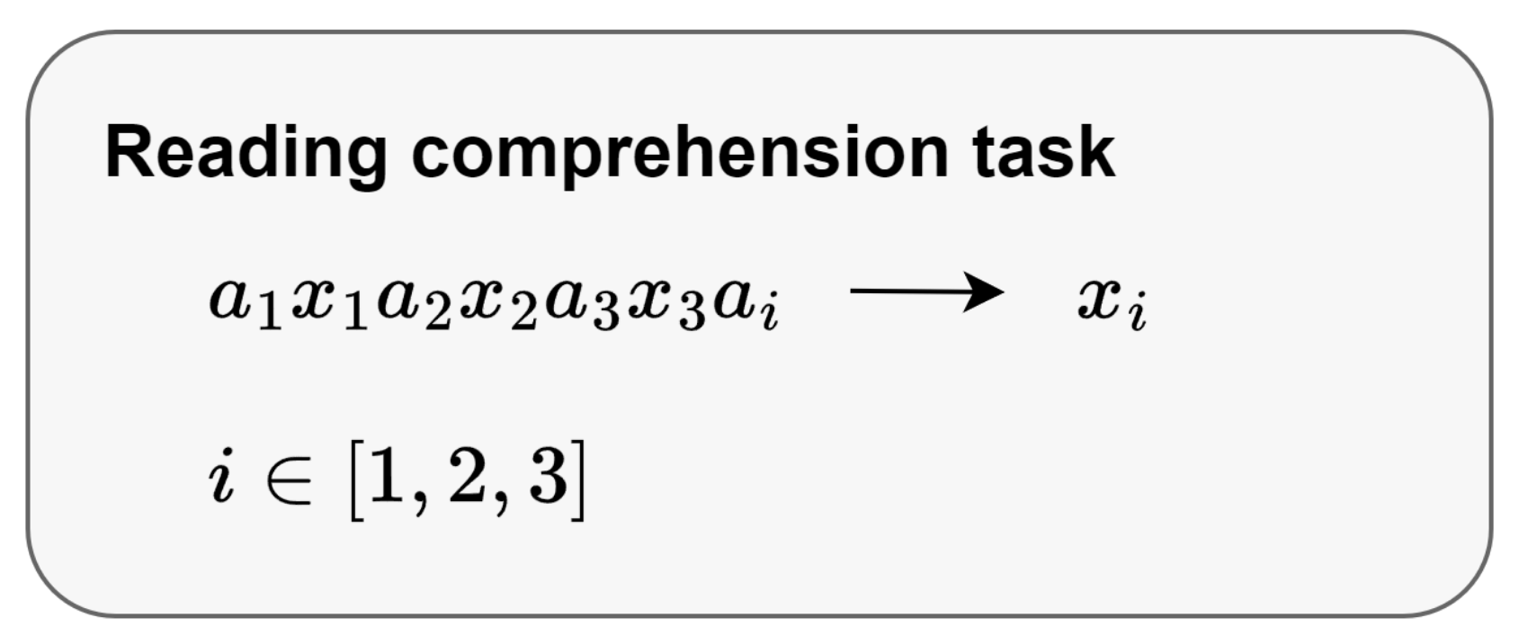
Reading comprehension task

Slide 26
Classification task
In Finland , the city of Forssa has said it will not pay compensation to food industry companies HK Ruokatalo and Atria for the lye leak into tap water that occurred in March 2008 . negative;
In the reporting period , the company 's operating profit grew by 43.2 % to EUR 6 million . positive;
Circulation revenue has increased by 5 % in Finland and 4 % in Sweden in 2008 . positive;
The Baltimore Police and Fire Pension , which has about $ 1.5 billion , lost about $ 3.5 million in Madoff Ponzi scheme . negative;
HELSINKI Thomson Financial - Shares in Cargotec fell sharply in early afternoon trade after the cargo handling group posted a surprise drop in April-June profits , which overshadowed the large number of new orders received during the three months . negative;
The acquisition will have an immediate positive impact on Aspocomp 's financial result . positive;
Before FKI , John Jiang has worked in several general manager or senior business consultant positions for international companies in China . neutral;
Here is the test example：
Net interest income was EUR 39.3 mn , up from EUR 32.7 mn .

Slide 27
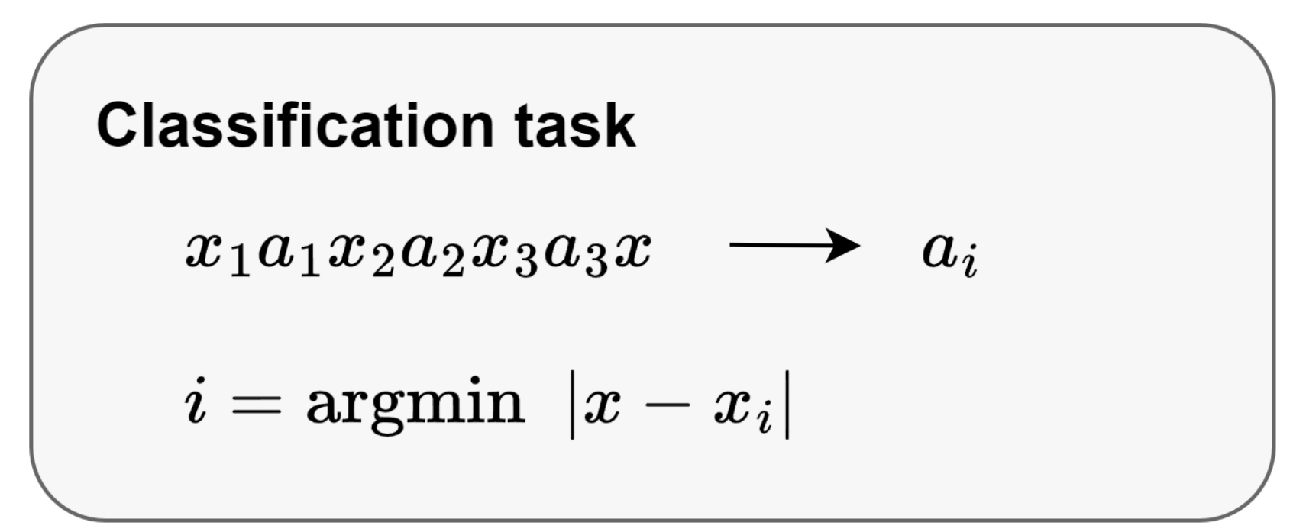
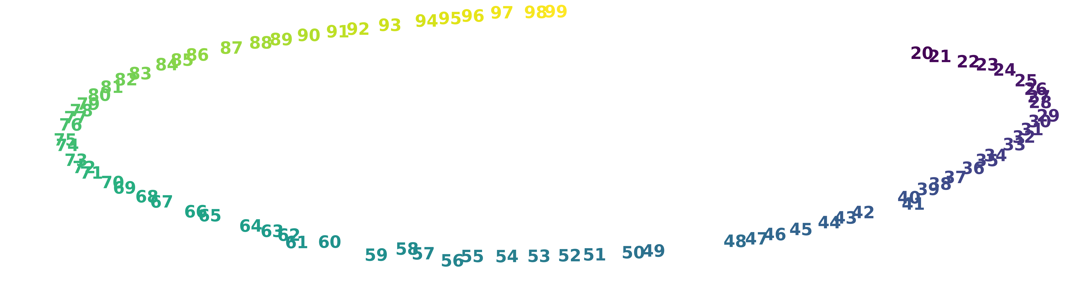
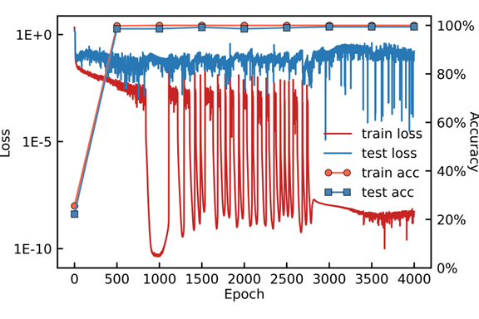
Classification task
The model constructs a representation of the size relationships among numbers in [20,100] using the training data.

Slide 28
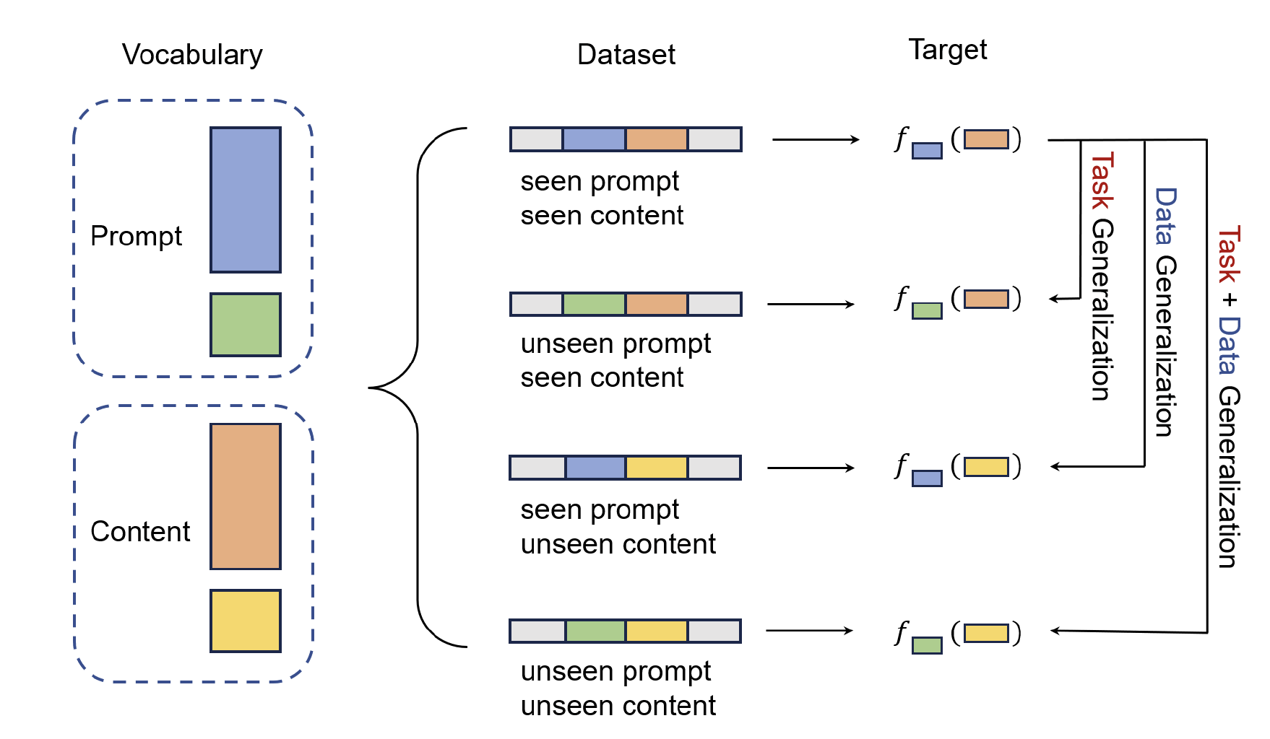
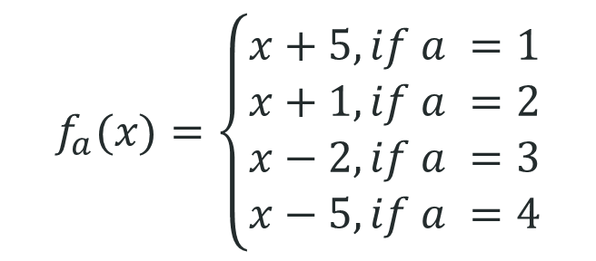
Composite task
$$f_{a}(x)=\left\{\begin{aligned}x+5, if a =1 \\ x+1, if a =2 \\ x−2, if a =3 \\ x−5, if a =4\end{aligned}\right.$$
In the experiment, pairs other than [..., 𝑥, 3, 4, ...] are used to construct the training dataset.

Slide 29
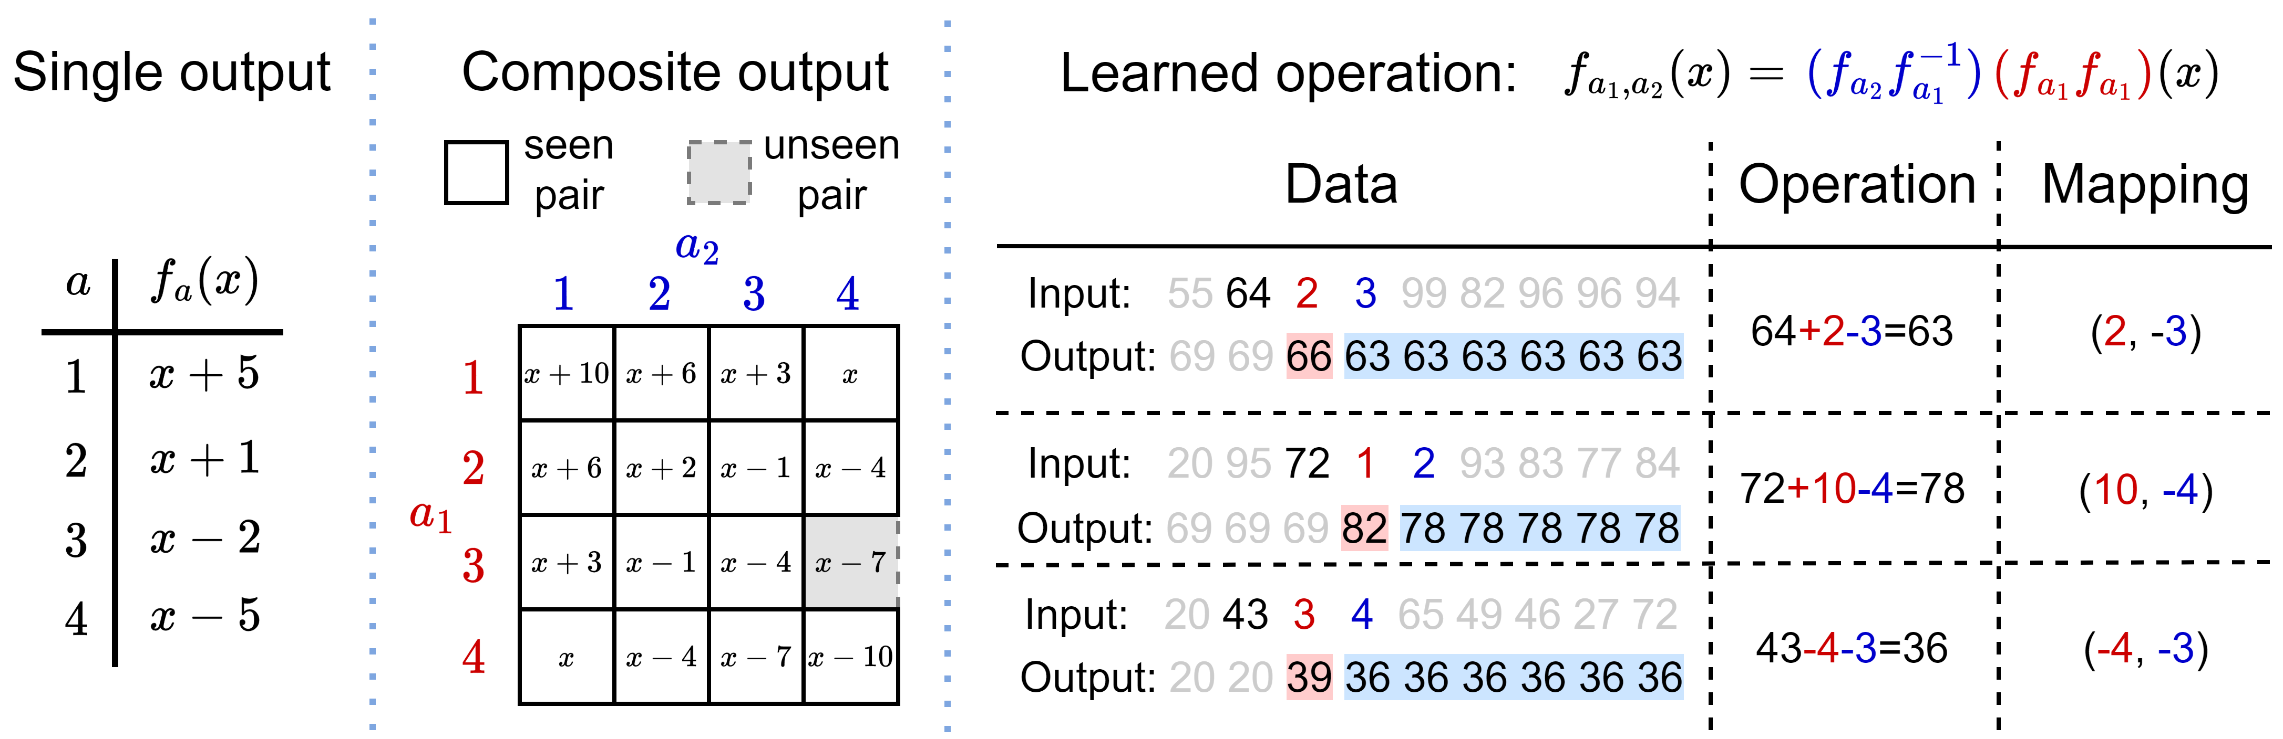
Composite task

Slide 30
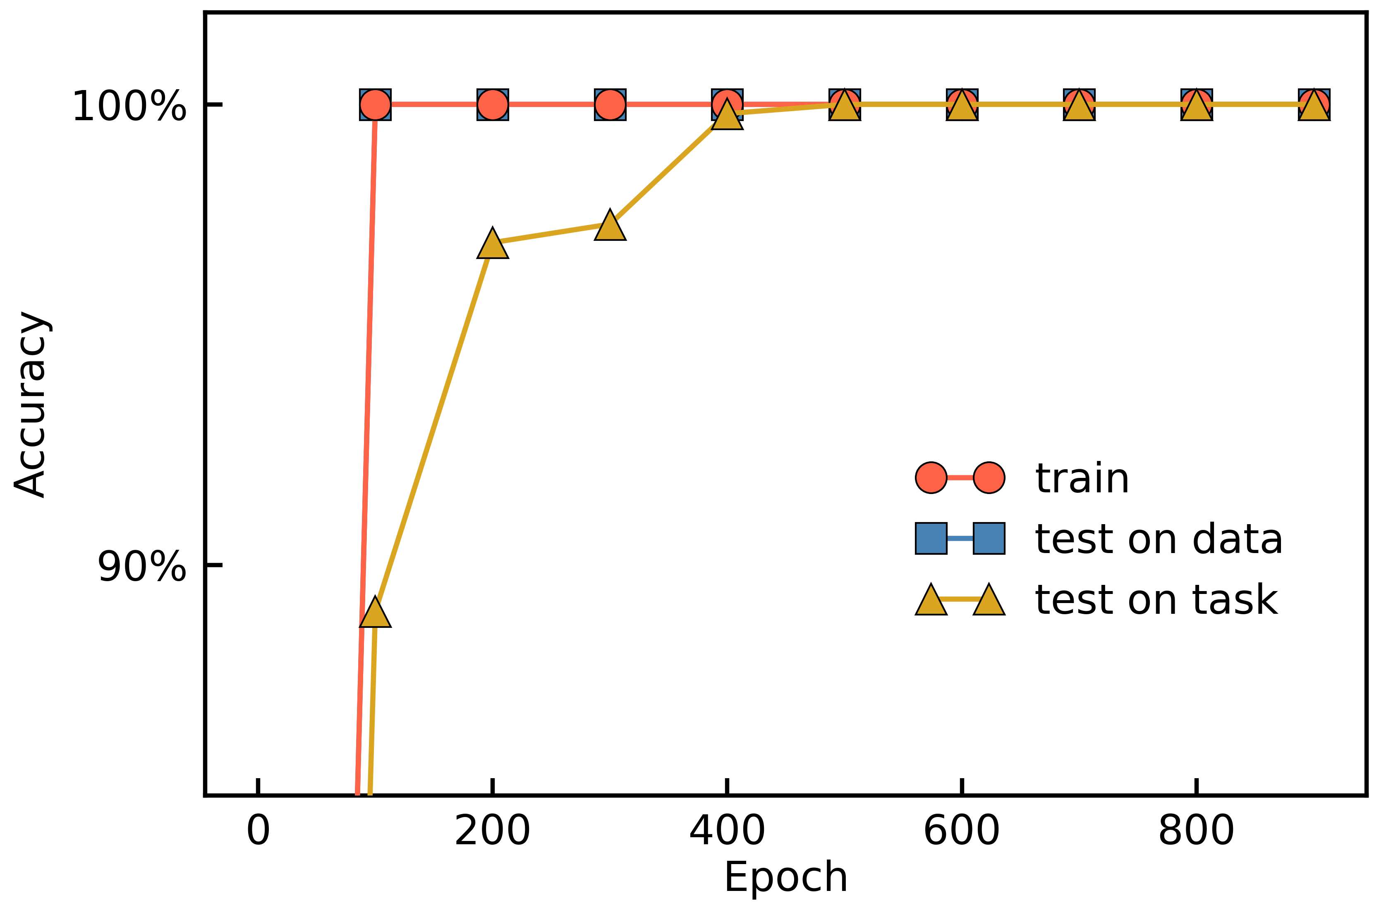
Composite task: learn task later

Slide 31
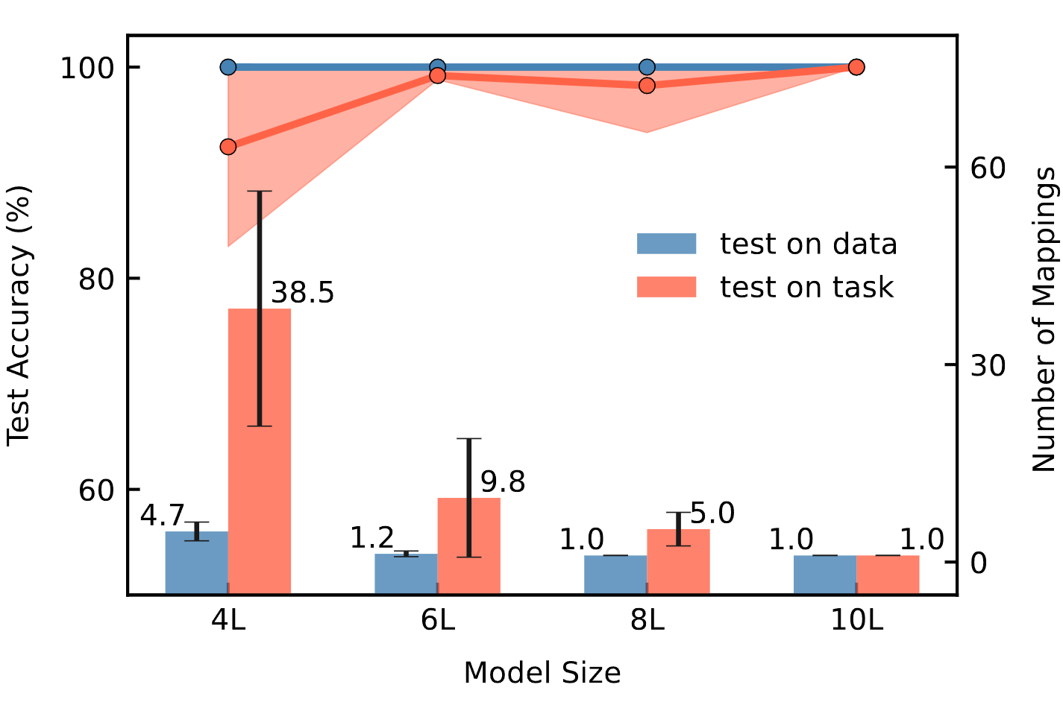
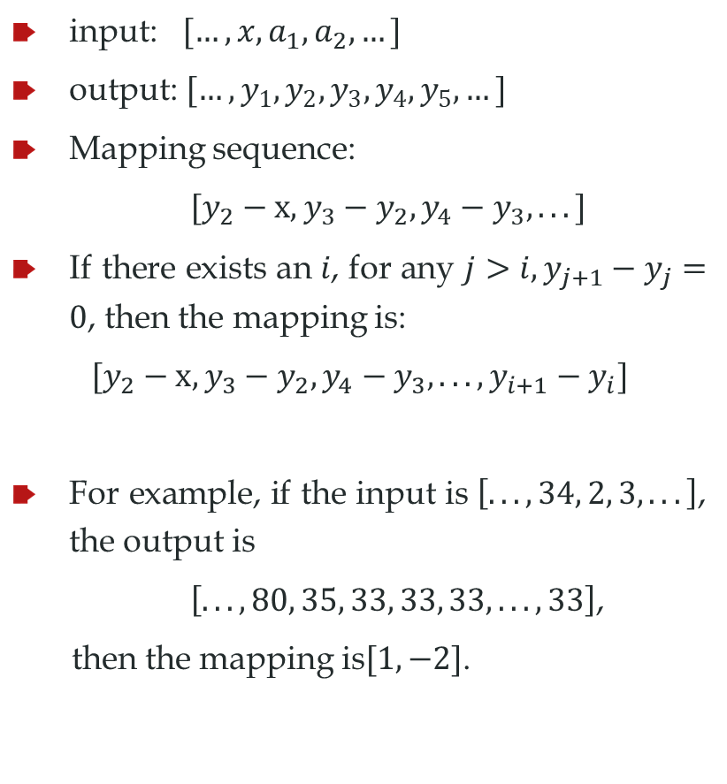
Composite task
input: $[…, x, a_{1}, a_{2}, …]$
output:$[…, y_{1},y_{2},y_{3},y_{4},y_{5},…]$
Mapping sequence:
$[y_{2}−x, y_{3}−y_{2}, y_{4}−y_{3}, ...]$
If there exists an 𝑖, for any $j>i, y_{j+1}−y_{j}=0$, then the mapping is:
$$[y_{2}−x, y_{3}−y_{2}, y_{4}−y_{3}, ..., y_{i+1}−y_{i}]$$
For example, if the input is $\left[..., 34, 2, 3, ...\right]$, the output is
$\left[..., 80, 35, 33, 33, 33, ..., 33\right]$,
then the mapping is$[1, −2]$.

Slide 32
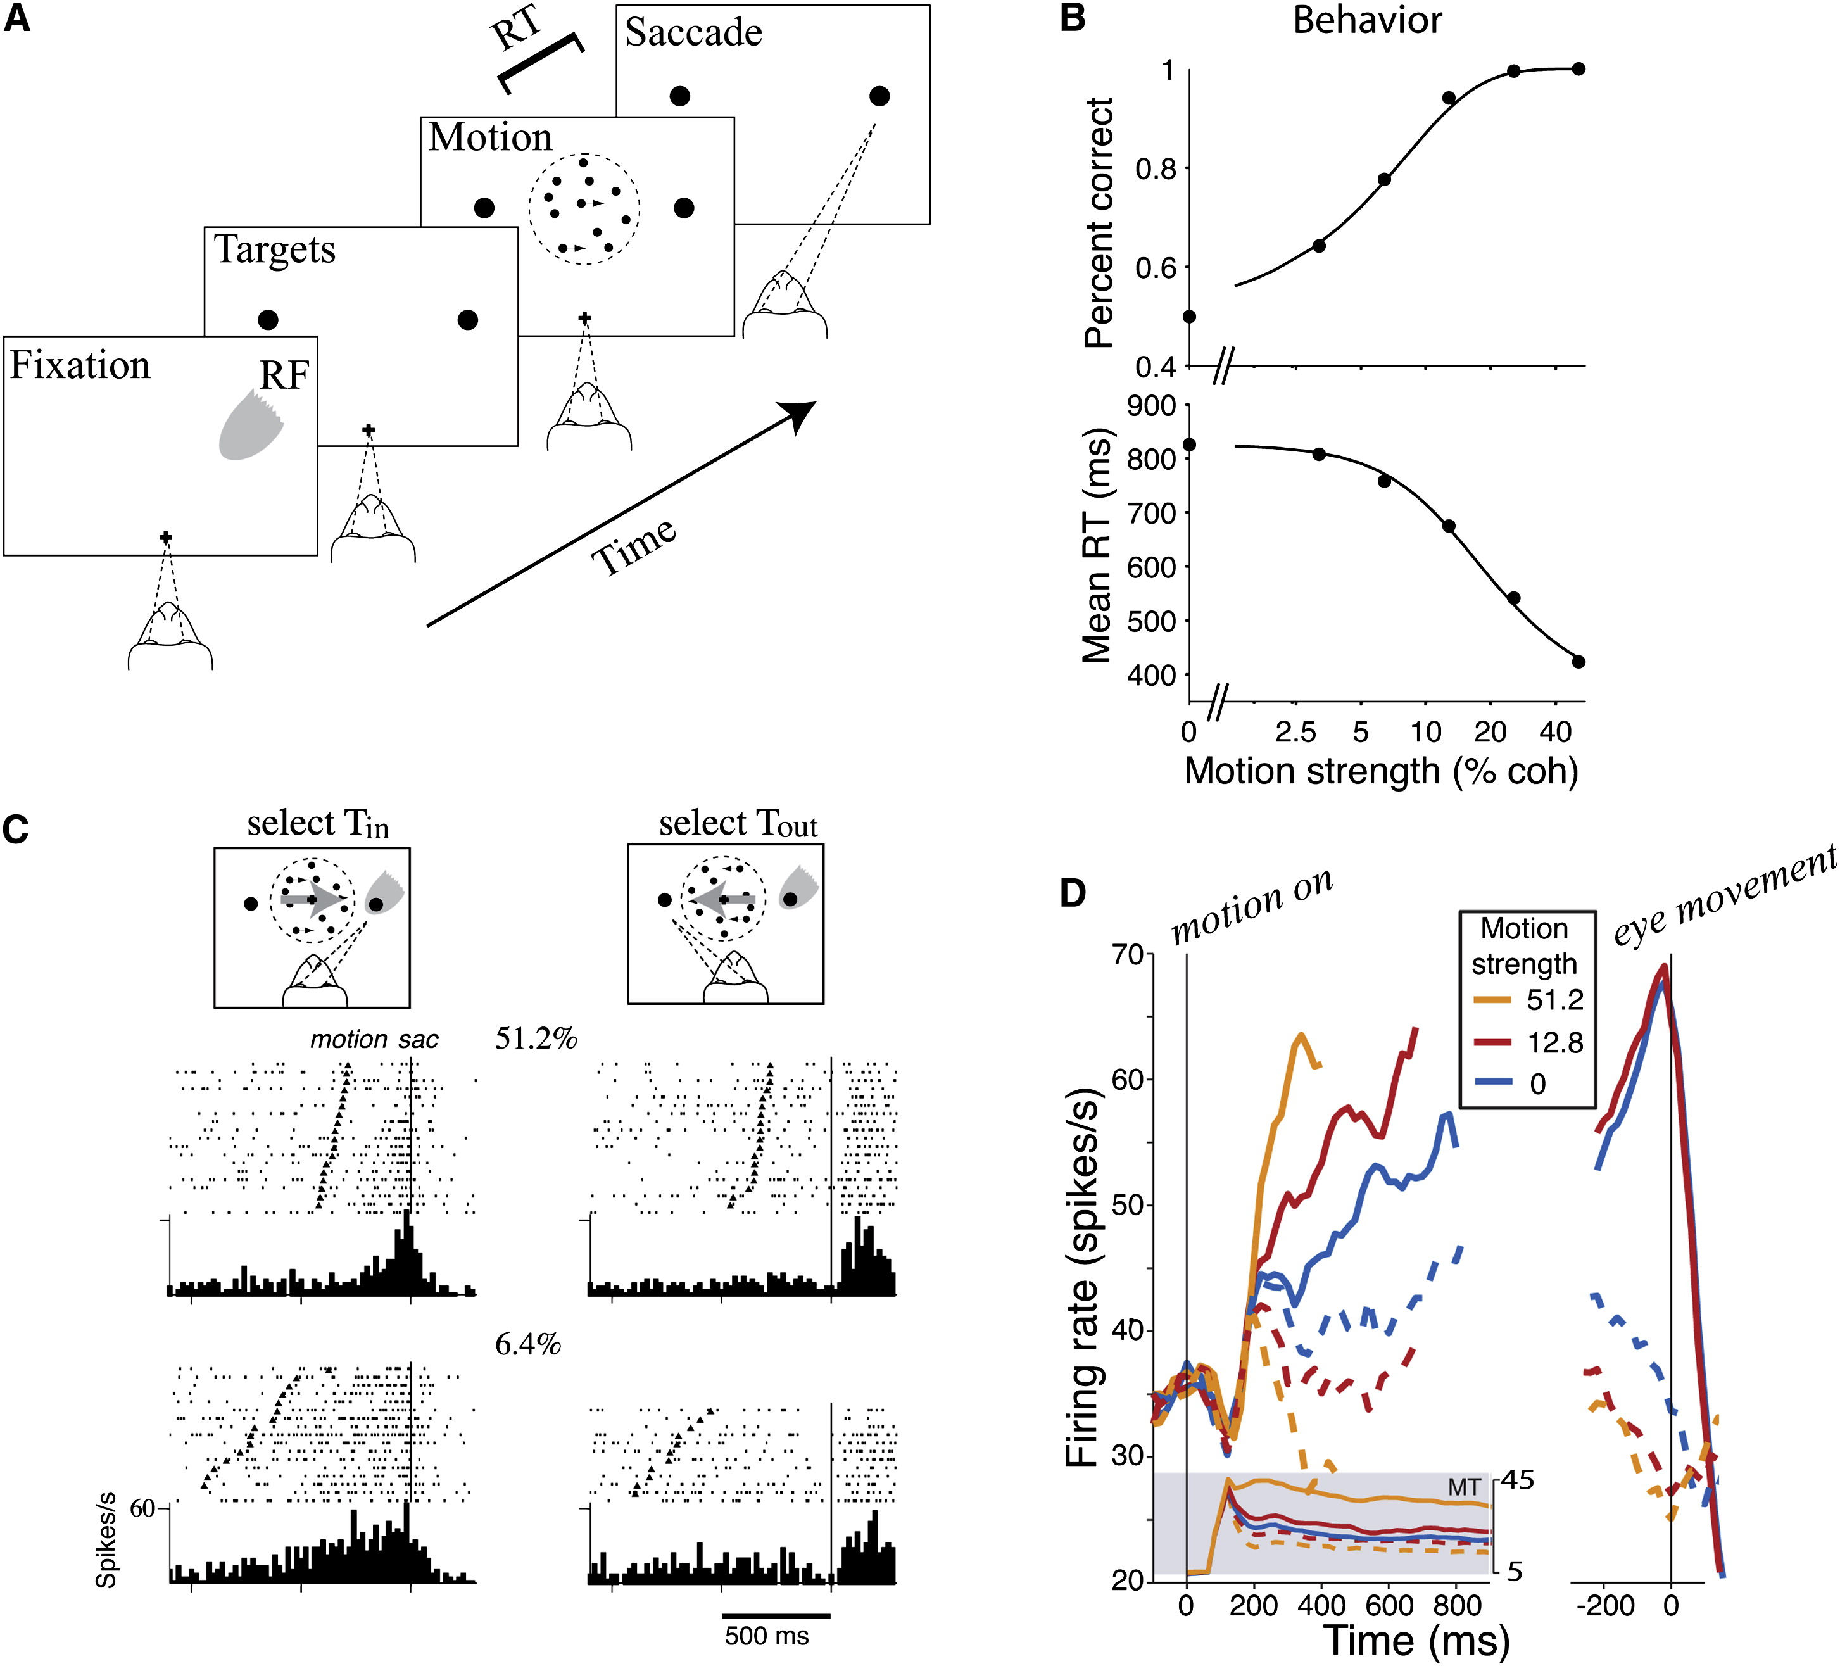
Working memory task
Xiao-Jing Wang, Decision Making in Recurrent Neuronal Circuits, Neuron, 2008

Slide 33
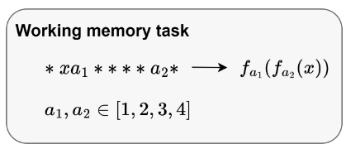
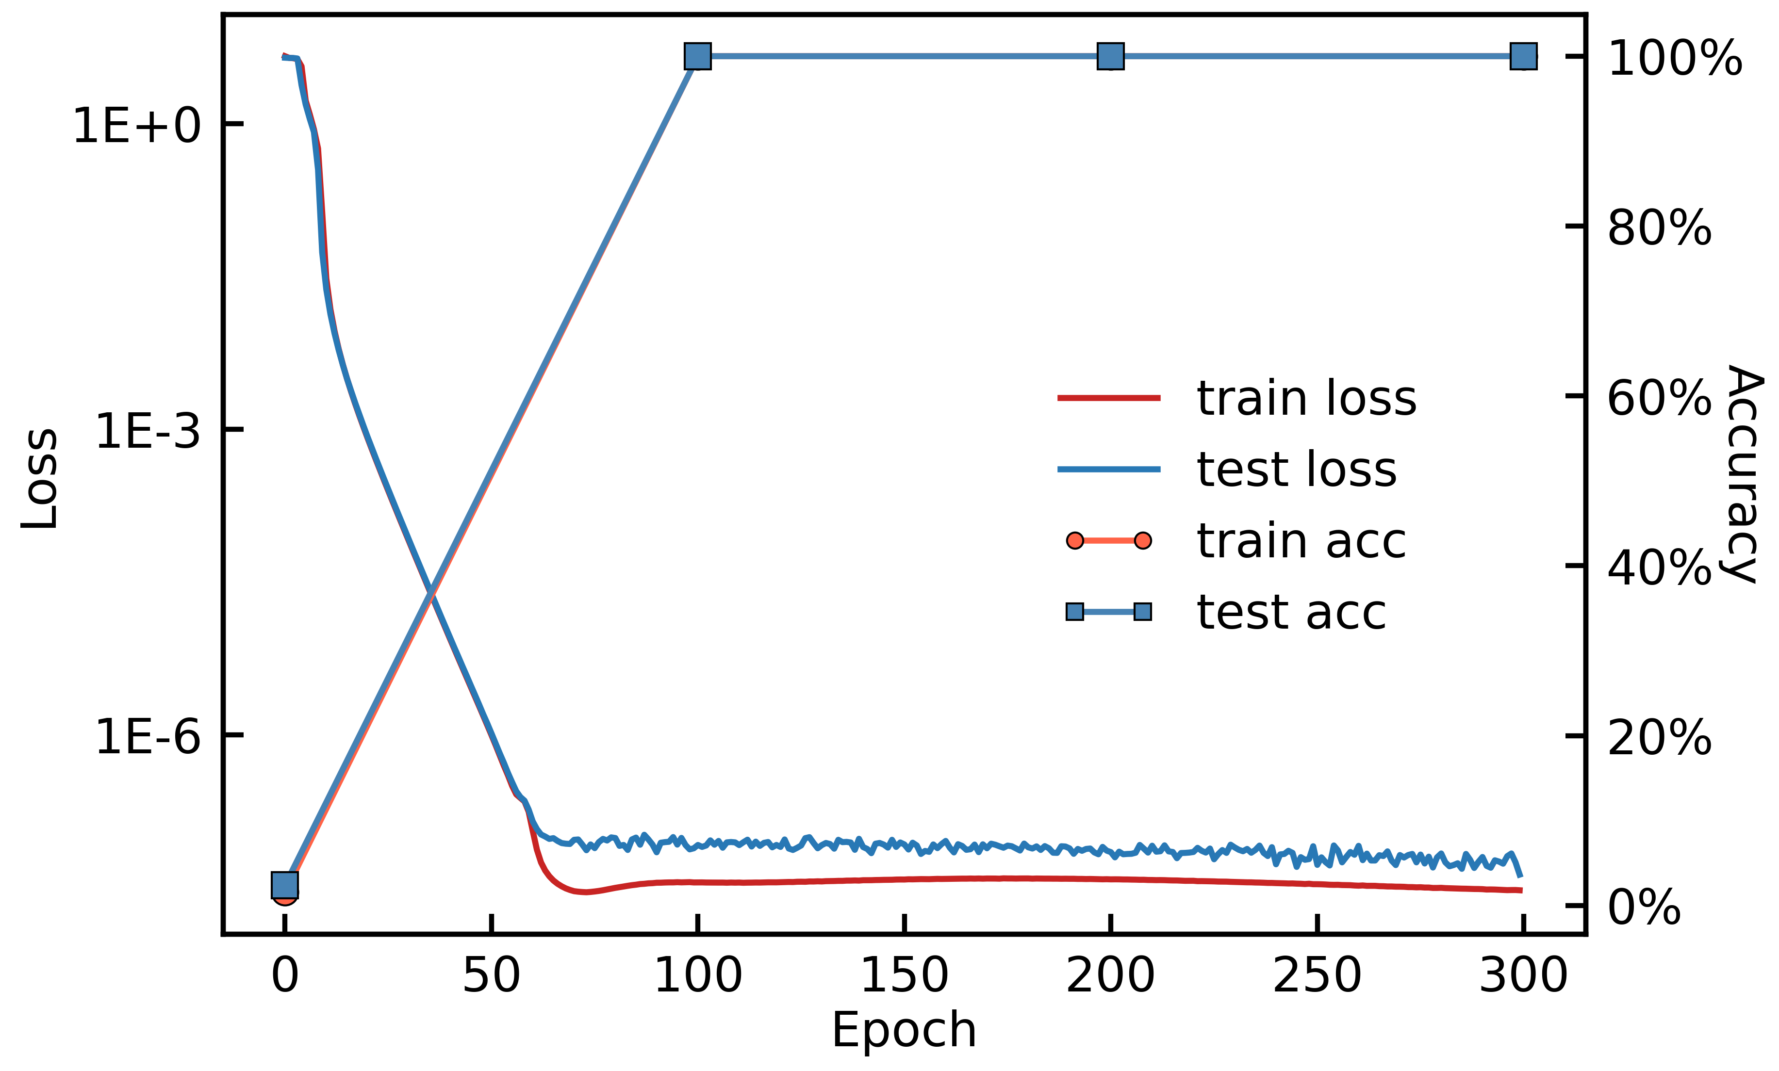
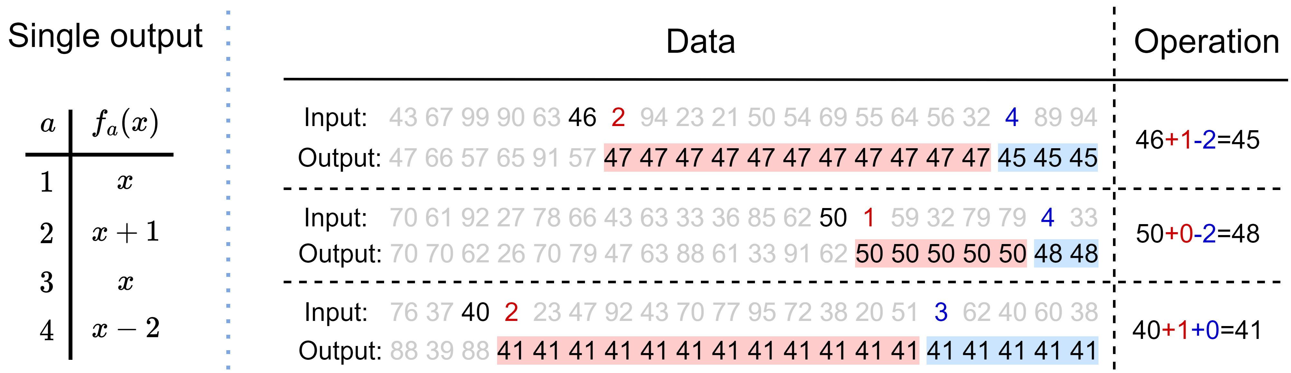
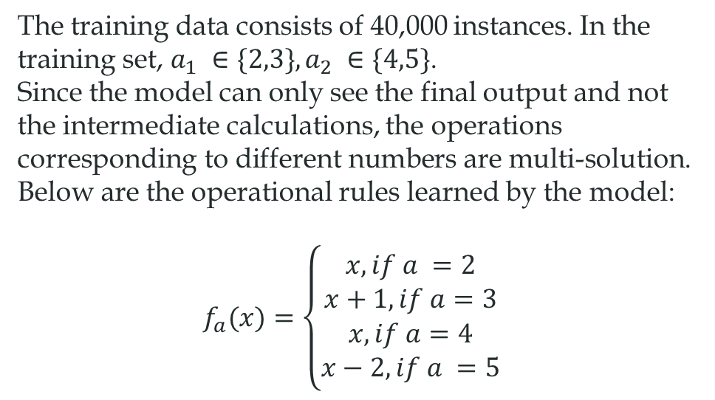
Working memory task
The training data consists of 40,000 instances. In the training set, $a_{1} ∈\{2,3\}, a_{2} ∈\{4,5\}$.
Since the model can only see the final output and not the intermediate calculations, the operations corresponding to different numbers are multi-solution. Below are the operational rules learned by the model:
$$f_{a}(x)=\left\{\begin{aligned}x, if a =2 \\ x+1, if a=3 \\ x, if a=4 \\ x−2, if a =5\end{aligned}\right.$$

Slide 34
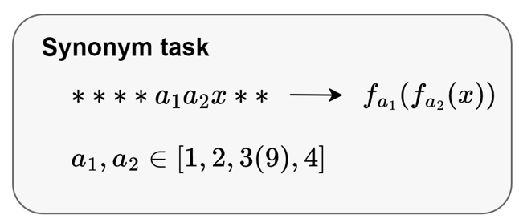
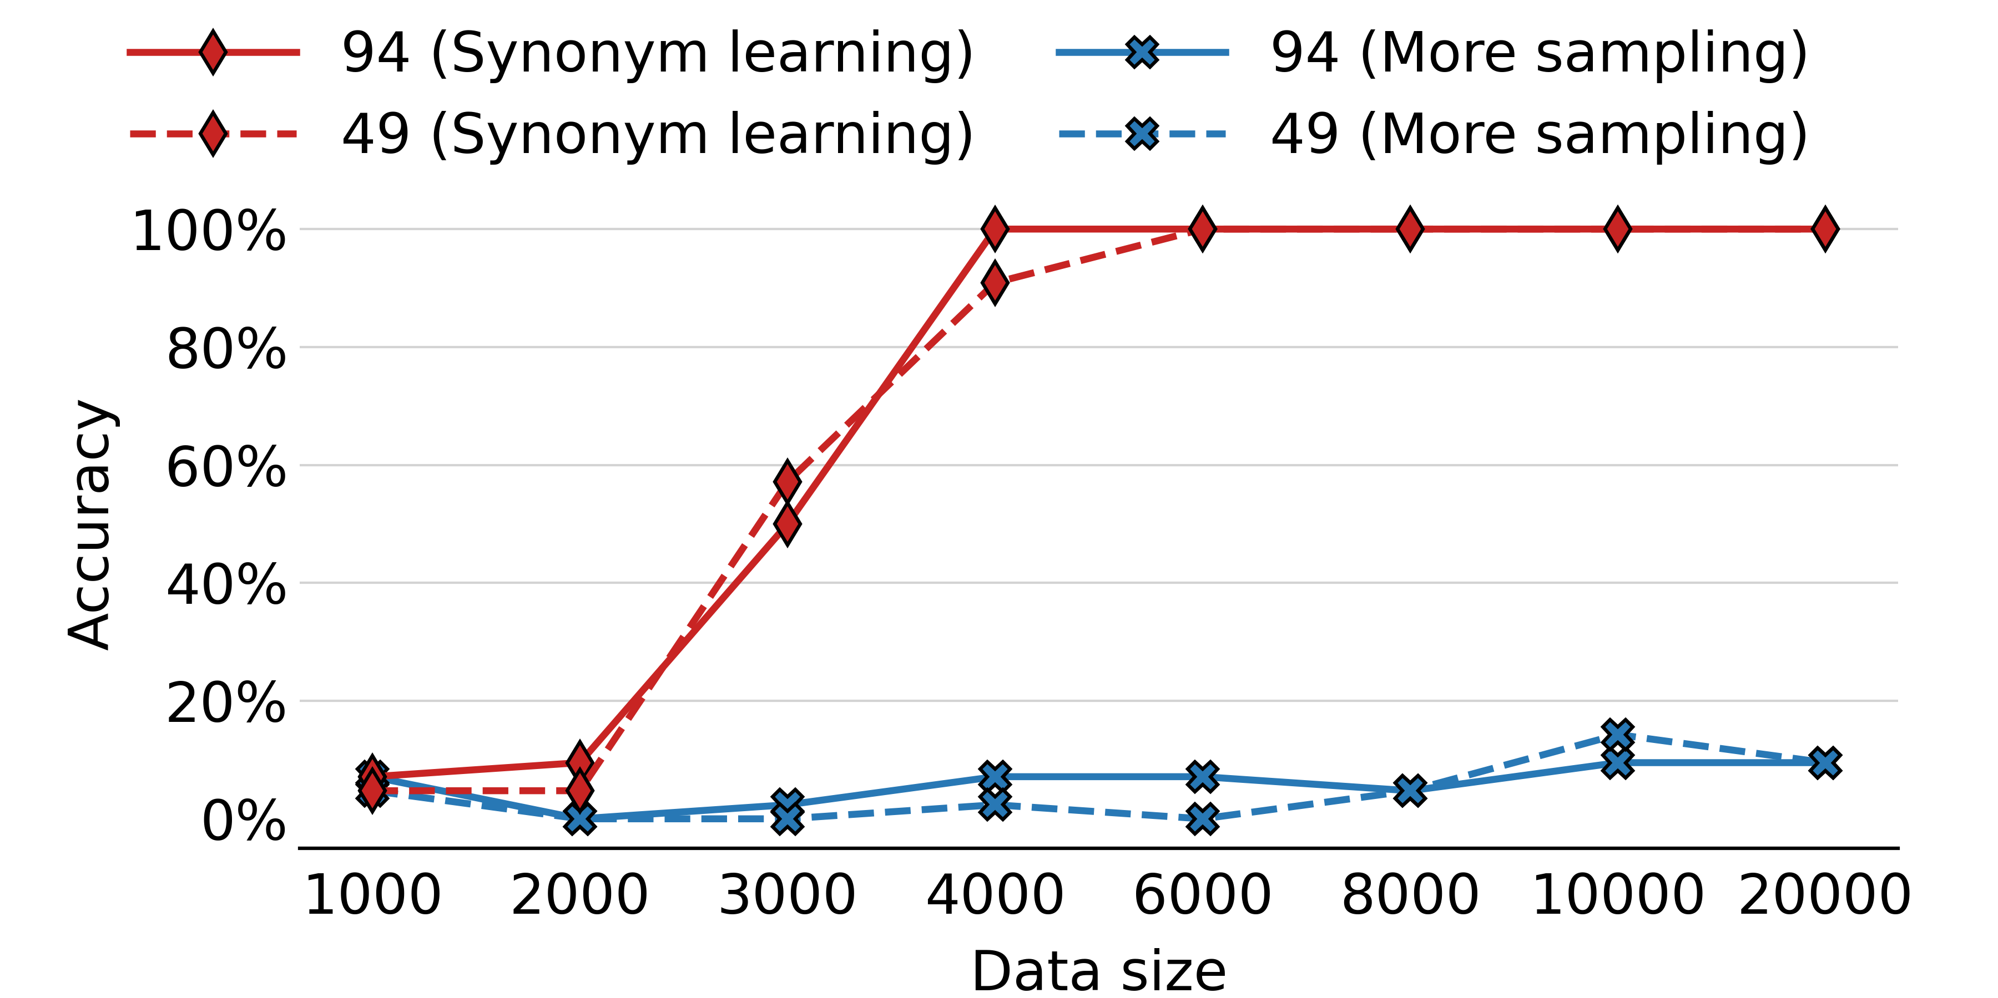
Synonym task
Original Set A：{(1,9), (2,9), (9,1), (9,2), (1,2), (1,4), (2,1), (4,1), (2,4), (4,2)}
Synonym learning: A+{(1,3), (3,1), (2,3), (3,2), (4,3), (3,4)}
More sampling: Proportionally increase the quantity of Set A, do not increase the variety of anchors.

Slide 35
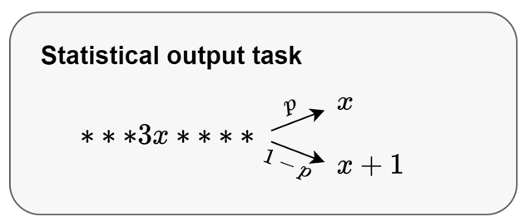
Statistical output task
Suppose 70% likes apple, 30% pear
Ask LLM to suggest apple or pear?

Slide 36
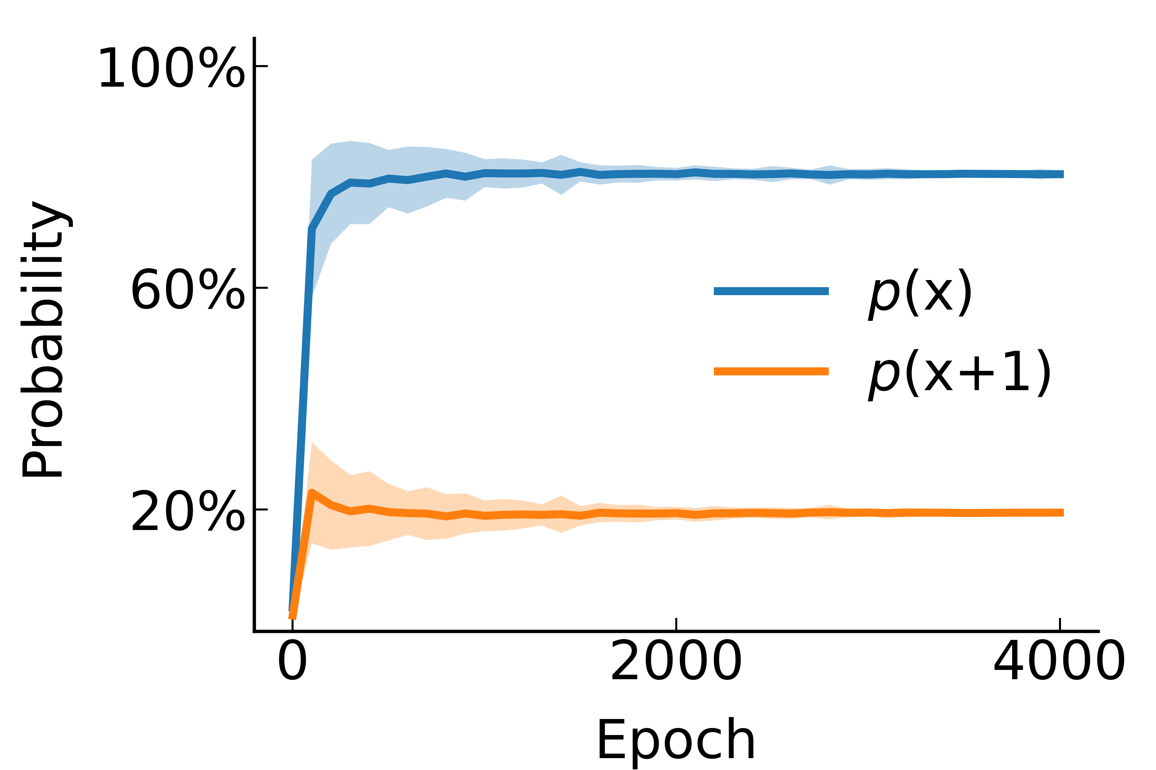
Statistical output task
80%: 3x→x
20%: 3x→(x+1)

Slide 37
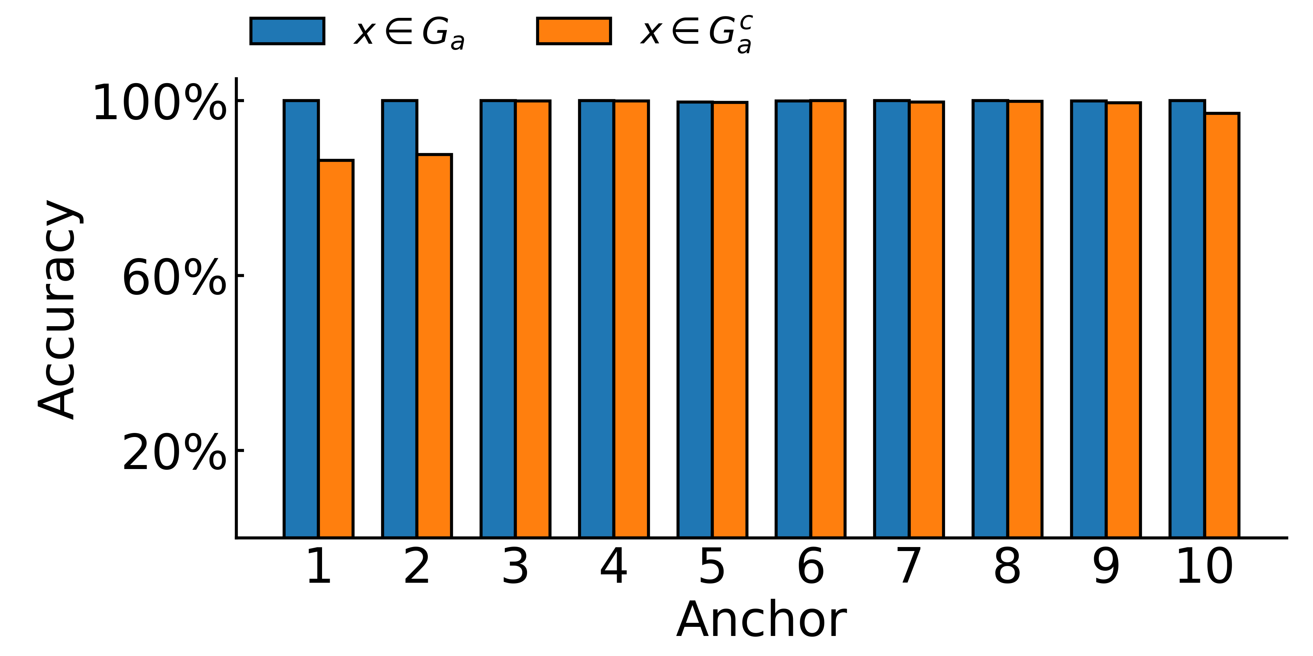

Multi-anchor Task
anchors: $a∈\left\{1,2,3,4,5,6,7,8,9,10\right\}$,
anchor function: $f_{a}(x) = x + a$,
test set: $G_{a}^{c}=[12 + 8a, 12 + 8(a+1)−1]$,
training set is $G_{a}=[20, 100]\backslash G_{a}^{c}$,
Generalize to unseen pair of anchor and key item.

Slide 38
Mechanism study

Slide 39
Mechanism study
Zhongwang Zhang#, Zhiwei Wang#, Junjie Yao, Zhangchen Zhou, Xiaolong Li, Weinan E, Zhi-Qin John Xu*, Anchor function: a type of benchmark functions for studying language models, arxiv 2401.08309

Slide 40
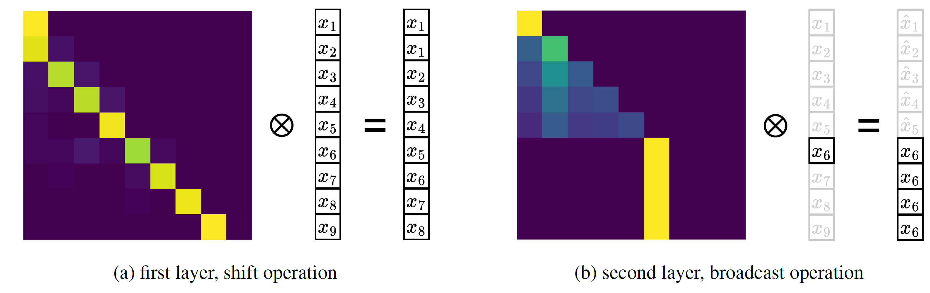
A brief explanation of a two-layer model
Shift: move the key item to the anchor position.
Residual: integration of information: the anchor item & the key item.
FNN: output the correct label.
Broadcast: transfers the correct label to the output position.
Zhongwang Zhang#, Zhiwei Wang#, Junjie Yao, Zhangchen Zhou, Xiaolong Li, Weinan E, Zhi-Qin John Xu*, Anchor function: a type of benchmark functions for studying language models, arxiv 2401.08309

Slide 41
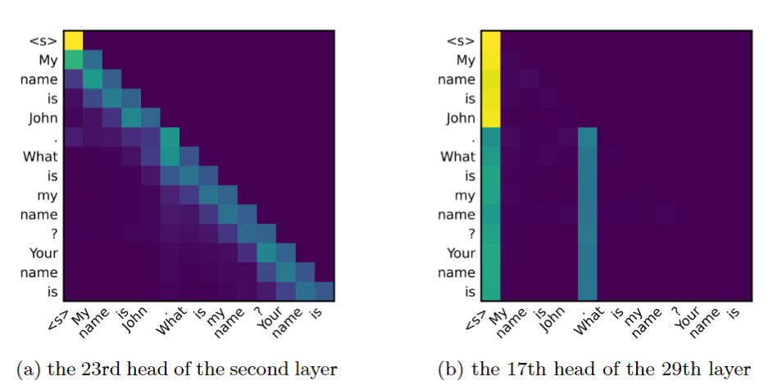
Shift and broadcast in Llama2-6B
Input: My name is John. What is my name? Your name is
Zhongwang Zhang#, Zhiwei Wang#, Junjie Yao, Zhangchen Zhou, Xiaolong Li, Weinan E, Zhi-Qin John Xu*, Anchor function: a type of benchmark functions for studying language models, arxiv 2401.08309

Slide 42
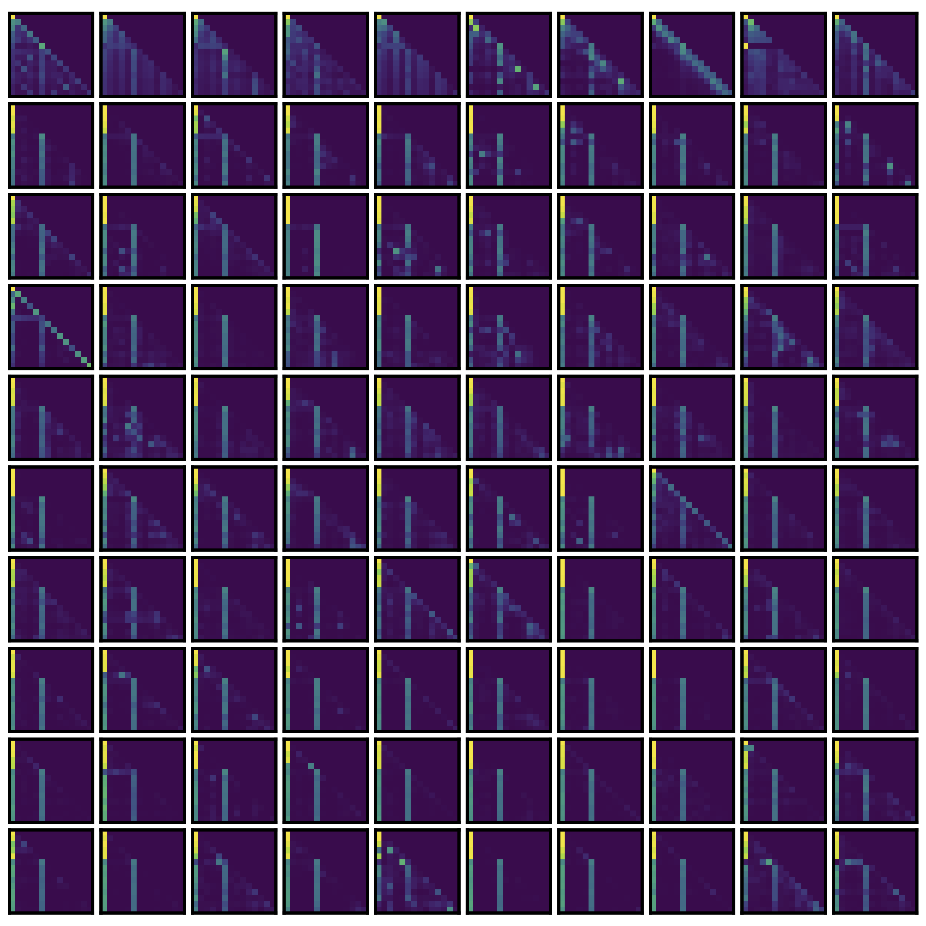
Shift and broadcast in Llama2-6B
Zhongwang Zhang#, Zhiwei Wang#, Junjie Yao, Zhangchen Zhou, Xiaolong Li, Weinan E, Zhi-Qin John Xu*, Anchor function: a type of benchmark functions for studying language models, arxiv 2401.08309

Slide 43
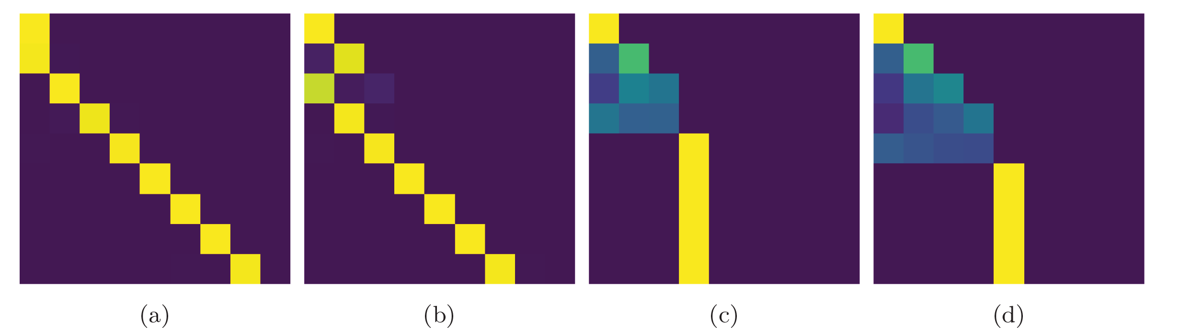
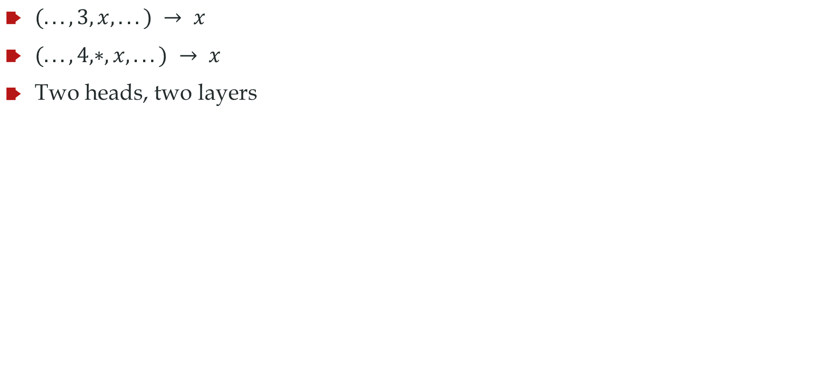
Data structure affects shifting
$(. . . , 3, x, . . .) → x$
$(. . . , 4,∗, x, . . .) → x$
Two heads, two layers

Slide 44
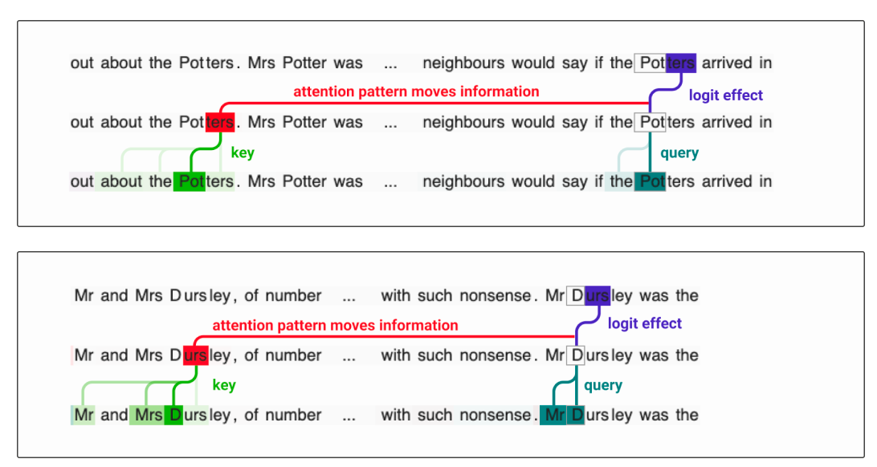
Induction head
Induction head is also a type of observed head that can help find the token that is the same as the current token in the previous sequence and output the next token of the same token.
Elhage, Nelson, et al. "A mathematical framework for transformer circuits." Transformer Circuits Thread 1 (2021).

Slide 45
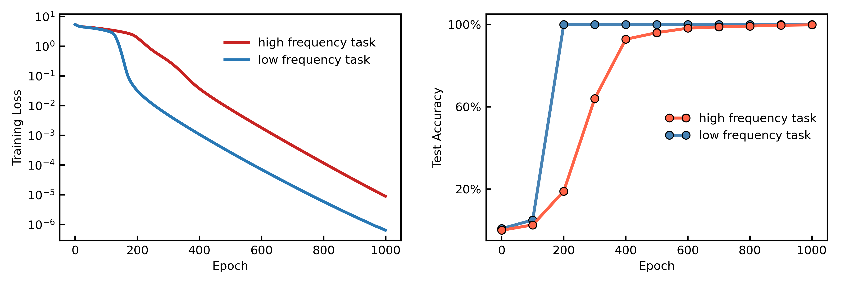
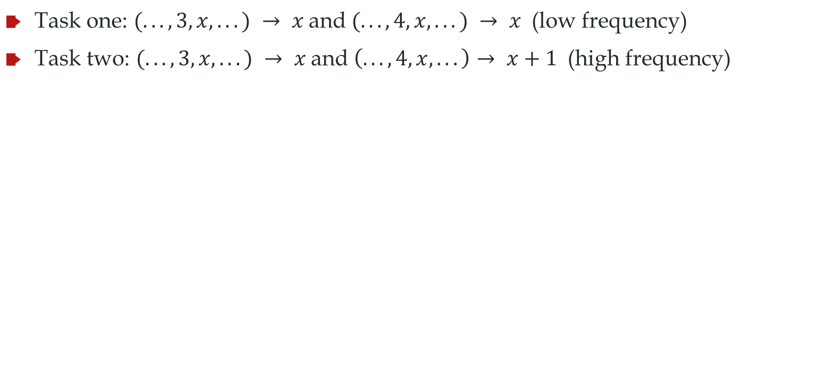
Frequency principle in anchor function
Task one: $(. . . , 3, x, . . .) → x$ and $(. . . , 4, x, . . .) → x$ (low frequency)
Task two: $(. . . , 3, x, . . .) → x$ and $\left(. . . , 4, x, . . .\right)→ x+1$ (high frequency)
Low frequency task learns fast

Slide 46
Mechanism
Shift operation
Q and K parallel for different rows
Fusion operation
resnet
Broadcast operation
Anchor special direction

